Slide 1
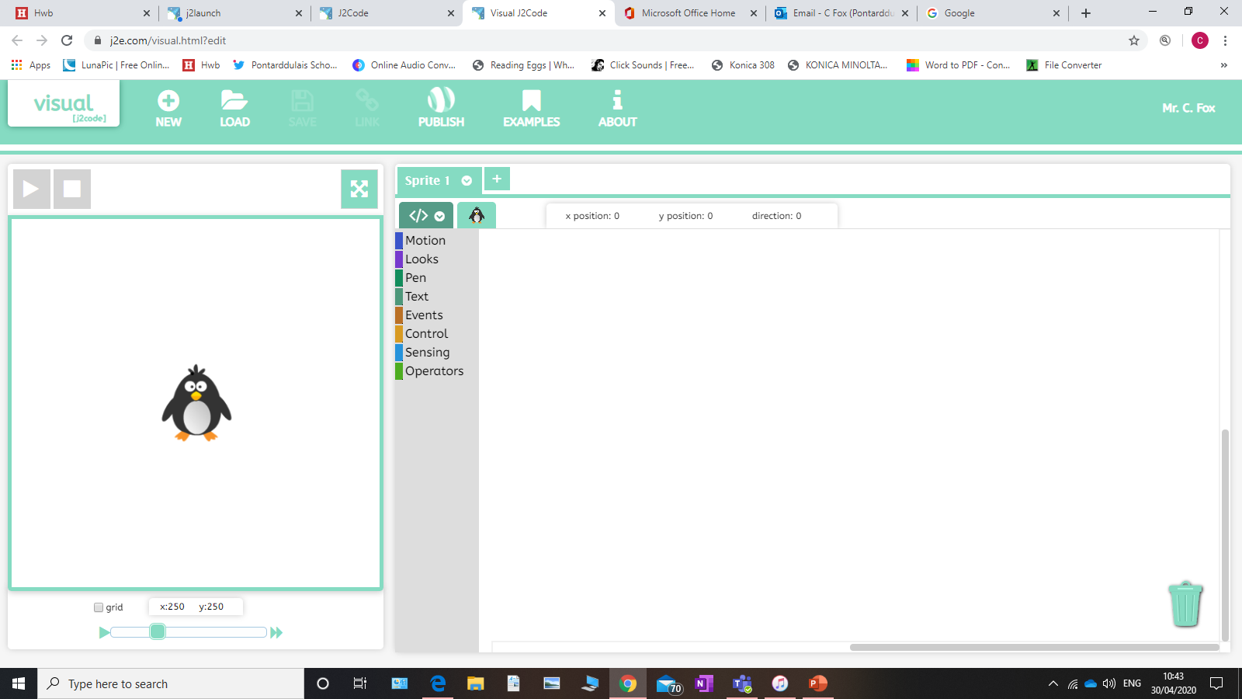
Coding with J2Code
Converstaion

Slide 2
Section 1
Making your sprite speak.

Slide 3
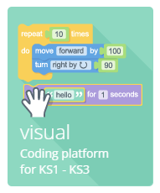
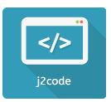
Opening Coding
Go to J2E on your HWB page and search for this symbol for J2Code.
Once in enter the visual section of coding.

Slide 4
Coding Screen
Your coding screen looks as such. The large screen to the left is your main gaming screen. The coloured list is all commands to control your sprite (the penguin). Above the list if a list of all sprites. You can have as many as you want and programme them all separately.

Slide 5
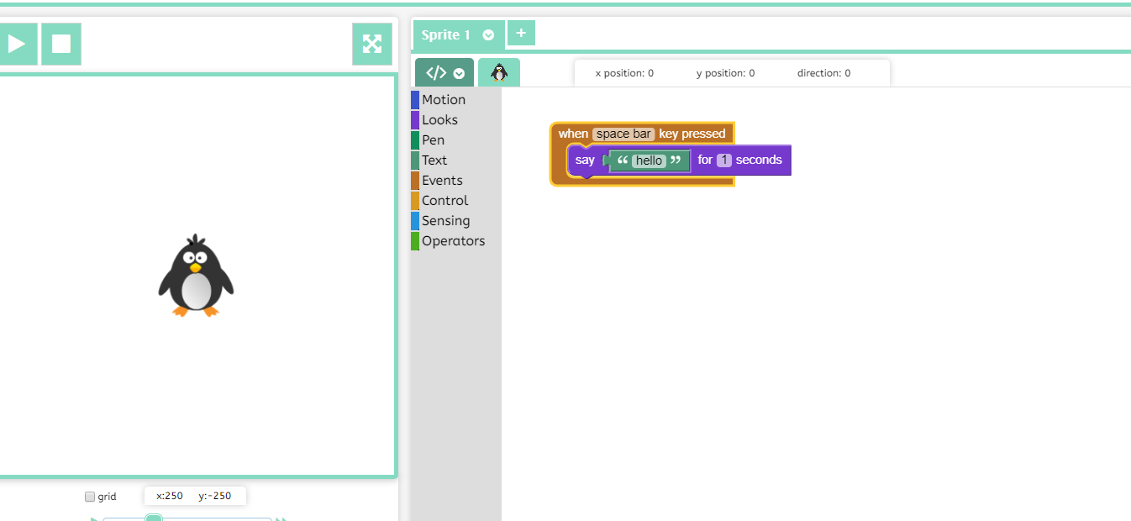
Basic coding
Create the following code. This will allow your sprite to say hello for 1 second.
Challenge: can you make the penguin say something different and for a longer length of time.

Slide 6
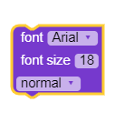
Changing the look of your writing
By adding this block in, you can alter how your sprite’s speech looks. Insert this above your character’s speech inside the orange block.

Slide 7
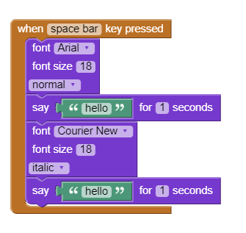
More lines of speech
By adding more of the same blocks in, you can create multiple lines of speech, and change the look of each line. Remember to write down what you want your sprite to say.

Slide 8
Section 2
Making your sprite have a converstaion.

Slide 9
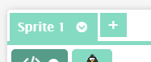
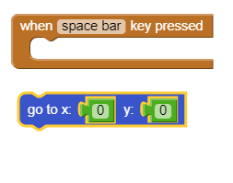
Creating another sprite
To create another sprite, click on the plus symbol next to the sprite symbol. Position him where you want him to go on the screen.
Challenge: Use the blocks below on both sprites so they appear in specific places. Remember to give different x and y numbers

Slide 10
Making them have a conversation
You can make your second sprite speak in the same way as the other. However, they will speak at the same time. There are two methods to make the conversation work, an easy way and a hard way, and we will look at both.
Challenge: Can you use the text changing block to give each sprite a different look to their speech.

Slide 11
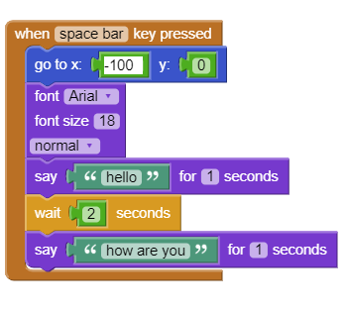
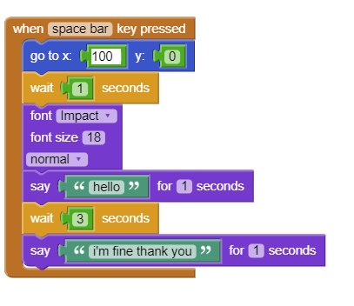
Conversation: Easy
Sprite 1
In both sprites, you will see they speak for so long. In the Control blocks there is a wait command. Use that with the correct length of time to create a conversation.
Sprite 2

Slide 12
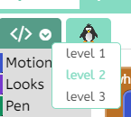
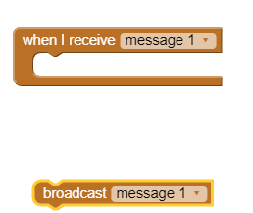
Conversation: Hard
This may become complicated with length of time. Another way is to broadcast a message. This means a sprite sends out a silent message. If the other sprite is set to receive it it will follow its programme. Set the codes to level 3 as shown, and in Events, you will see these 2 blocks.

Slide 13
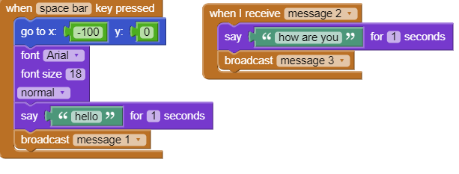
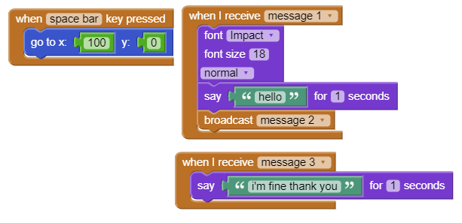
Conversation: Hard cont
Sprite 1
Rework your codes with the new broadcasts. You can name the broadcast whatever you wish. Always remember to create a new one each time.
Sprite 2

Slide 14
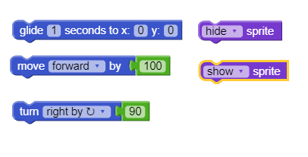
Animating your sprite
Using whichever method you decided upon, you can add movement in to make your characters animated. You can have them move around the screen, appear or disappear using these blocks.
Challenge: Experiment with these blocks and see what you can do.

Slide 15
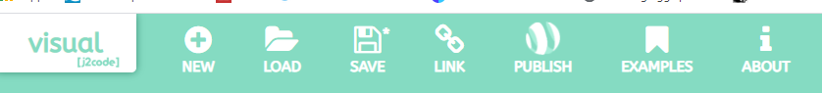
Completing the project.
When you are happy, click on the save symbol above and give your project a name.

Slide 16

Sharing
You can view your coding work either by pressing the My Code section in the J2Code menu, or going straight to your files. Remember to share with your teachers.

Slide 17
Challenge
Can you create other sprites can make them join in on the conversation?
Using conversations and movements, can you make a small movie?
Use the coding to have the sprite tell your teacher all that you have done.

