Slide 1
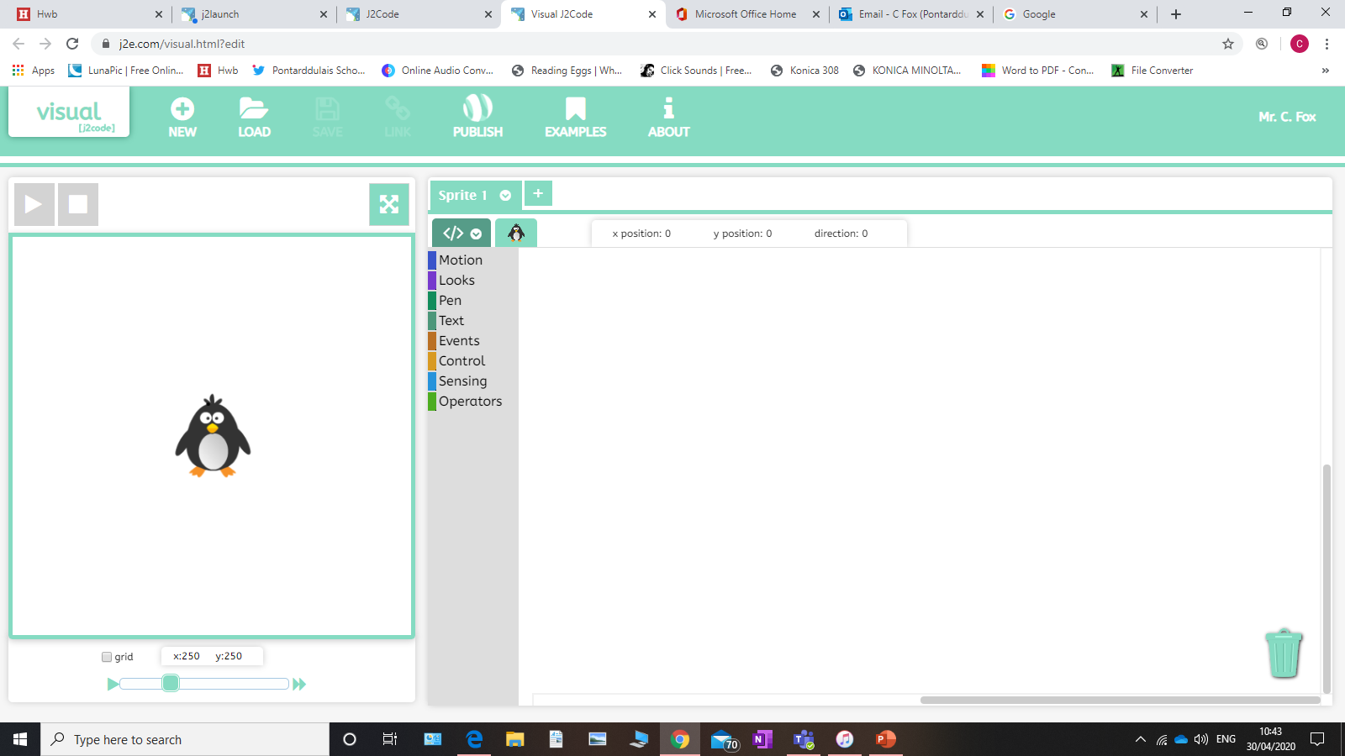
Coding with J2Code
Paint

Slide 2
Section 1
Making your sprite move.

Slide 3
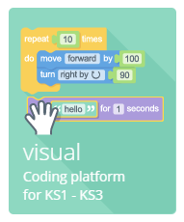
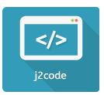
Opening Coding
Go to J2E on your HWB page and search for this symbol for J2Code.
Once in enter the visual section of coding.

Slide 4
Coding Screen
Your coding screen looks as such. The large screen to the left is your main gaming screen. The coloured list is all commands to control your sprite (the penguin). Above the list if a list of all sprites. You can have as many as you want and programme them all separately.

Slide 5
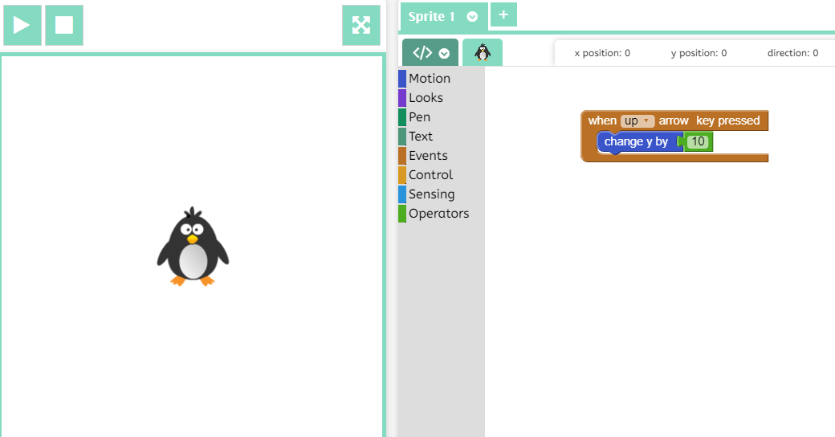
Basic coding
Create the following code. To do this, go to each option in the list, find the correct block, click and drag into the large white area. Each block is colour coded. Press the play button to try it out. Press stop and the penguin goes back to start.
Challenge: can you create more code the same way so right arrow moves right, left arrow moves left and down arrow moves down. Remember, x means left or right and y means up and down. Some values must be -

Slide 6
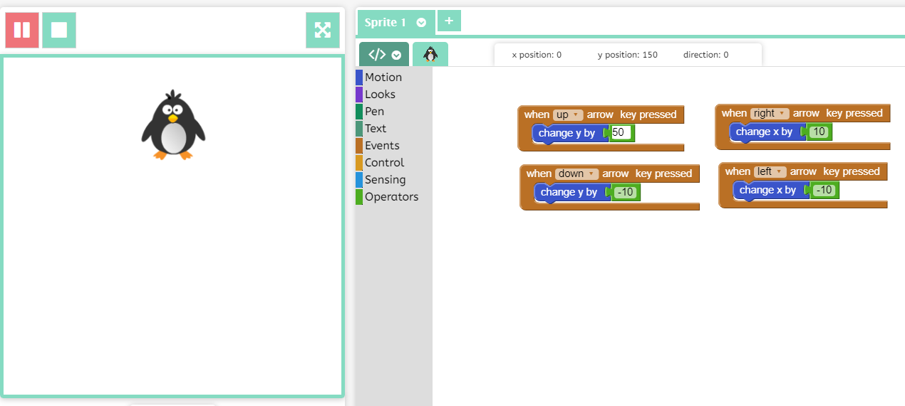
How your sprite moves
If you alter the numbers in the green blocks, the distance your sprite moves changes. The higher the number, the further it moves.

Slide 7
Section 2
Making your sprite paint.

Slide 8
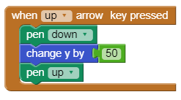
Creating a Variable
Change the movement code so it is like this. You will see that when you press up you leave a line. Press any other arrow there is no line.
Challenge: Repeat this for the other directions.

Slide 9
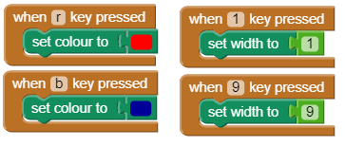
Line Thickness and colour
At the moment, you have a thin black line. Create the following codes. When done, try pressing the different numbers and letters before moving your sprite. See what happens.
Challenge: Create more colours and sizes. Try not to use colours that start with same letters, i.e. black and blue, pink and purple. If this happens, use a different letter. Also, you can only use numbers 1-9, although you could use 0 for 10. try different widths

Slide 10
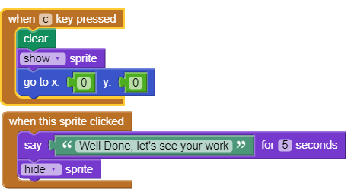
Finishing your artwork
Create the following codes. This will allow your sprite to speak to you and disappear so you can view your work. Then, when you press c, all work disappears and the penguin goes back to the start.

Slide 11
Section 3
Random Painting

Slide 12
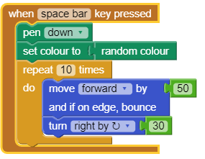
Random and automatic
Type in the following code. When you press space the penguin will move by itself. Try changing the values and see what happens.

Slide 13
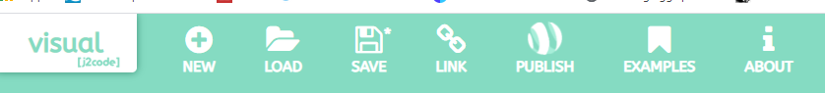
Completing the project.
When you are happy, click on the save symbol above and give your project a name.

Slide 14

Sharing
You can view your coding work either by pressing the My Code section in the J2Code menu, or going straight to your files. Remember to share with your teachers.

Slide 15
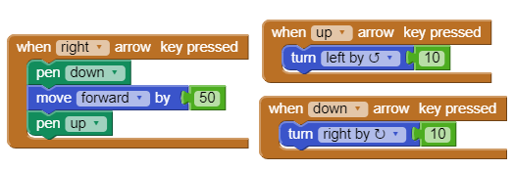
Challenge
Can you create other commands with different outcomes?
Give different values and see what your code does.
Can you make it so when you press right arrow you go forward, and then up arrow makes your sprite turn to the left, down arrow turns right, and left arrow has no value? See what happens. (Remove other arrow codes first)

