Slide 1

Language, Literacy & Communication Week 9
Fairtrade

Slide 2
Challenges:
Challenge 1: Fairtrade Comprehension
Decide on your level of challenge and complete the comprehension. This will help you gather information on Fairtrade.
Challenge 2: Mind Map
Research information on Fairtrade. Present your information in a mind map. Remember to group your information systematically.
Challenge 3: Fairtrade Persuasive Letter Writing
You are writing to a local supermarket. You want to persuade them of the benefits to everyone of ensuring that farmers in developing countries receive a fair price for their crops so that they will think more about the products that they stock. Remember that using evidence can give your arguments more influence.

Slide 3
Challenge 1:
Fairtrade Comprehension
Decide on your level of challenge and complete the comprehension.
This will help you gather information on Fairtrade.

Slide 4
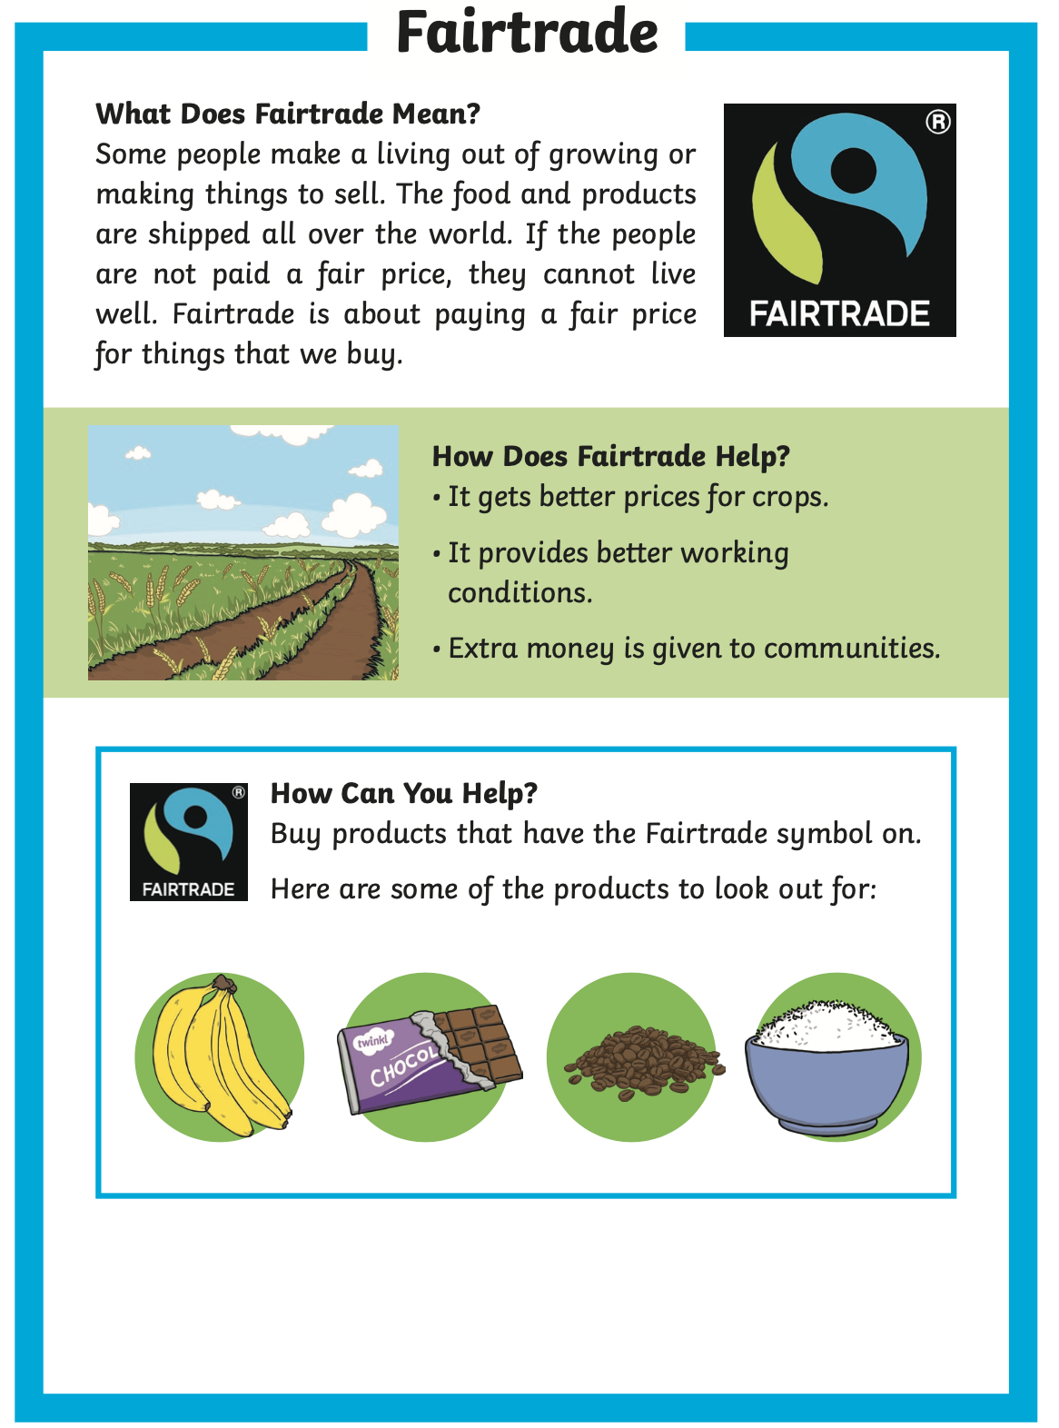
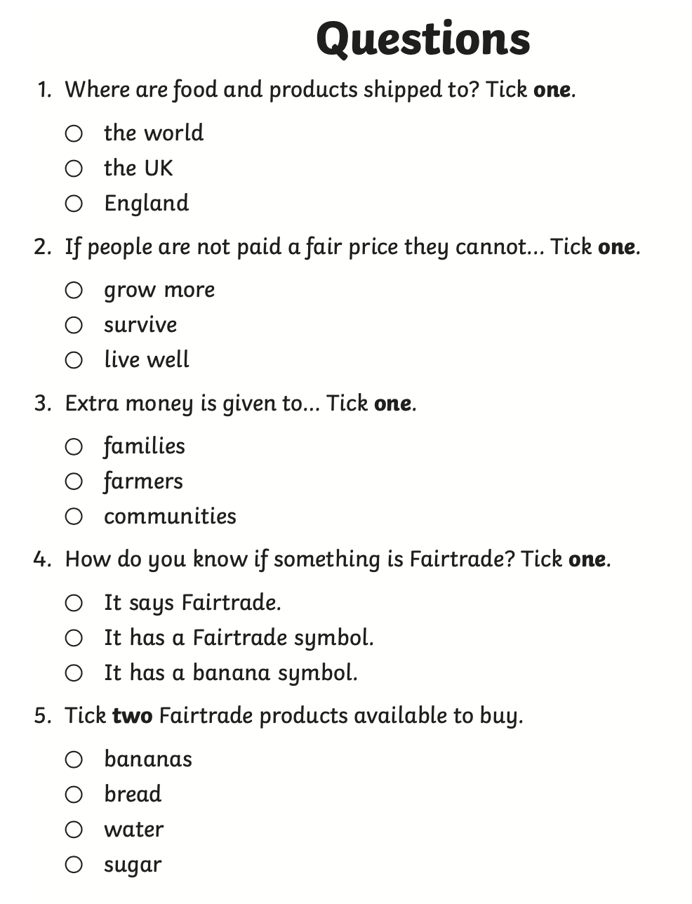

Reading Comprehension 1 Star Challenge

Slide 5
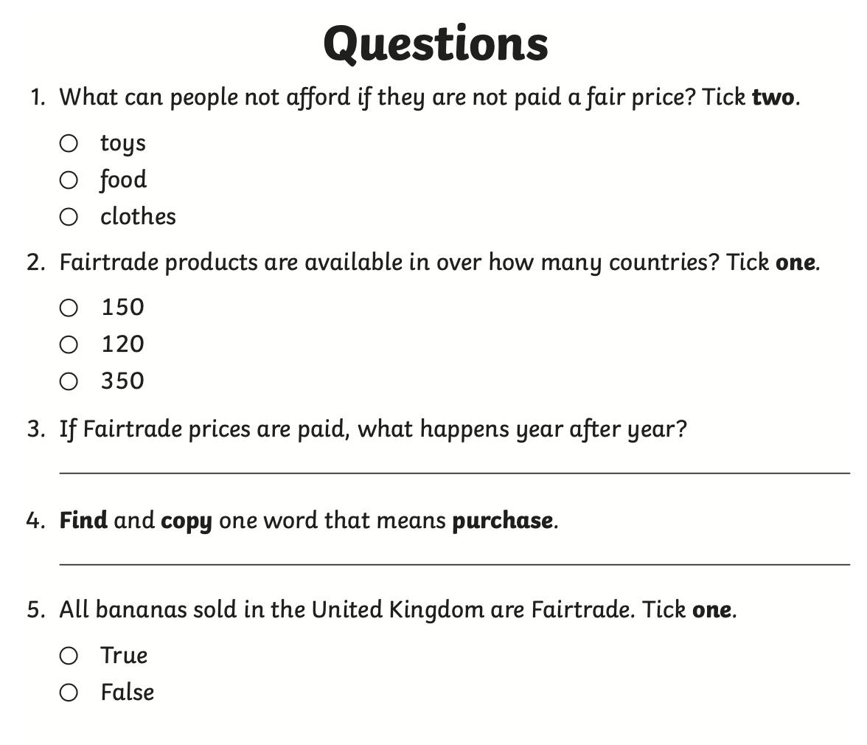
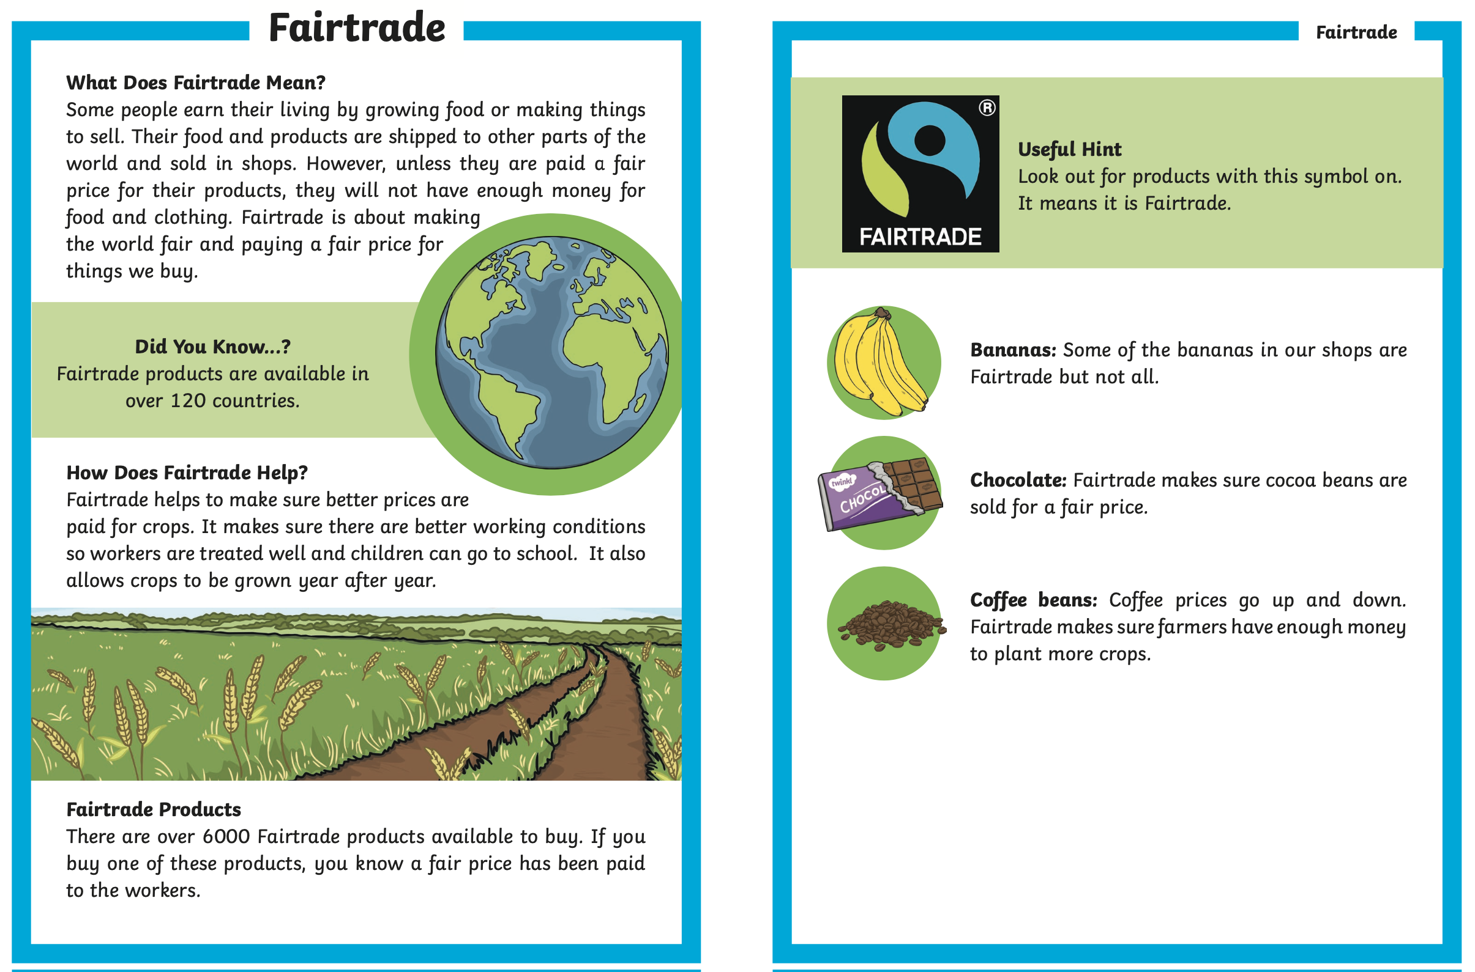
Reading Comprehension
2 Star Challenge

Slide 6
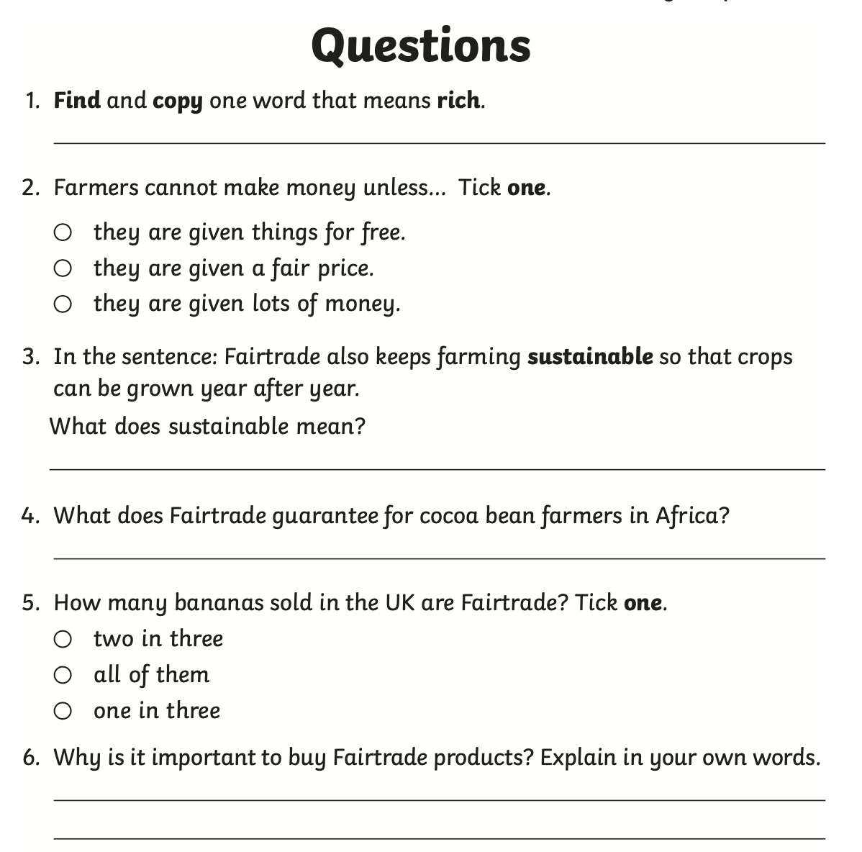
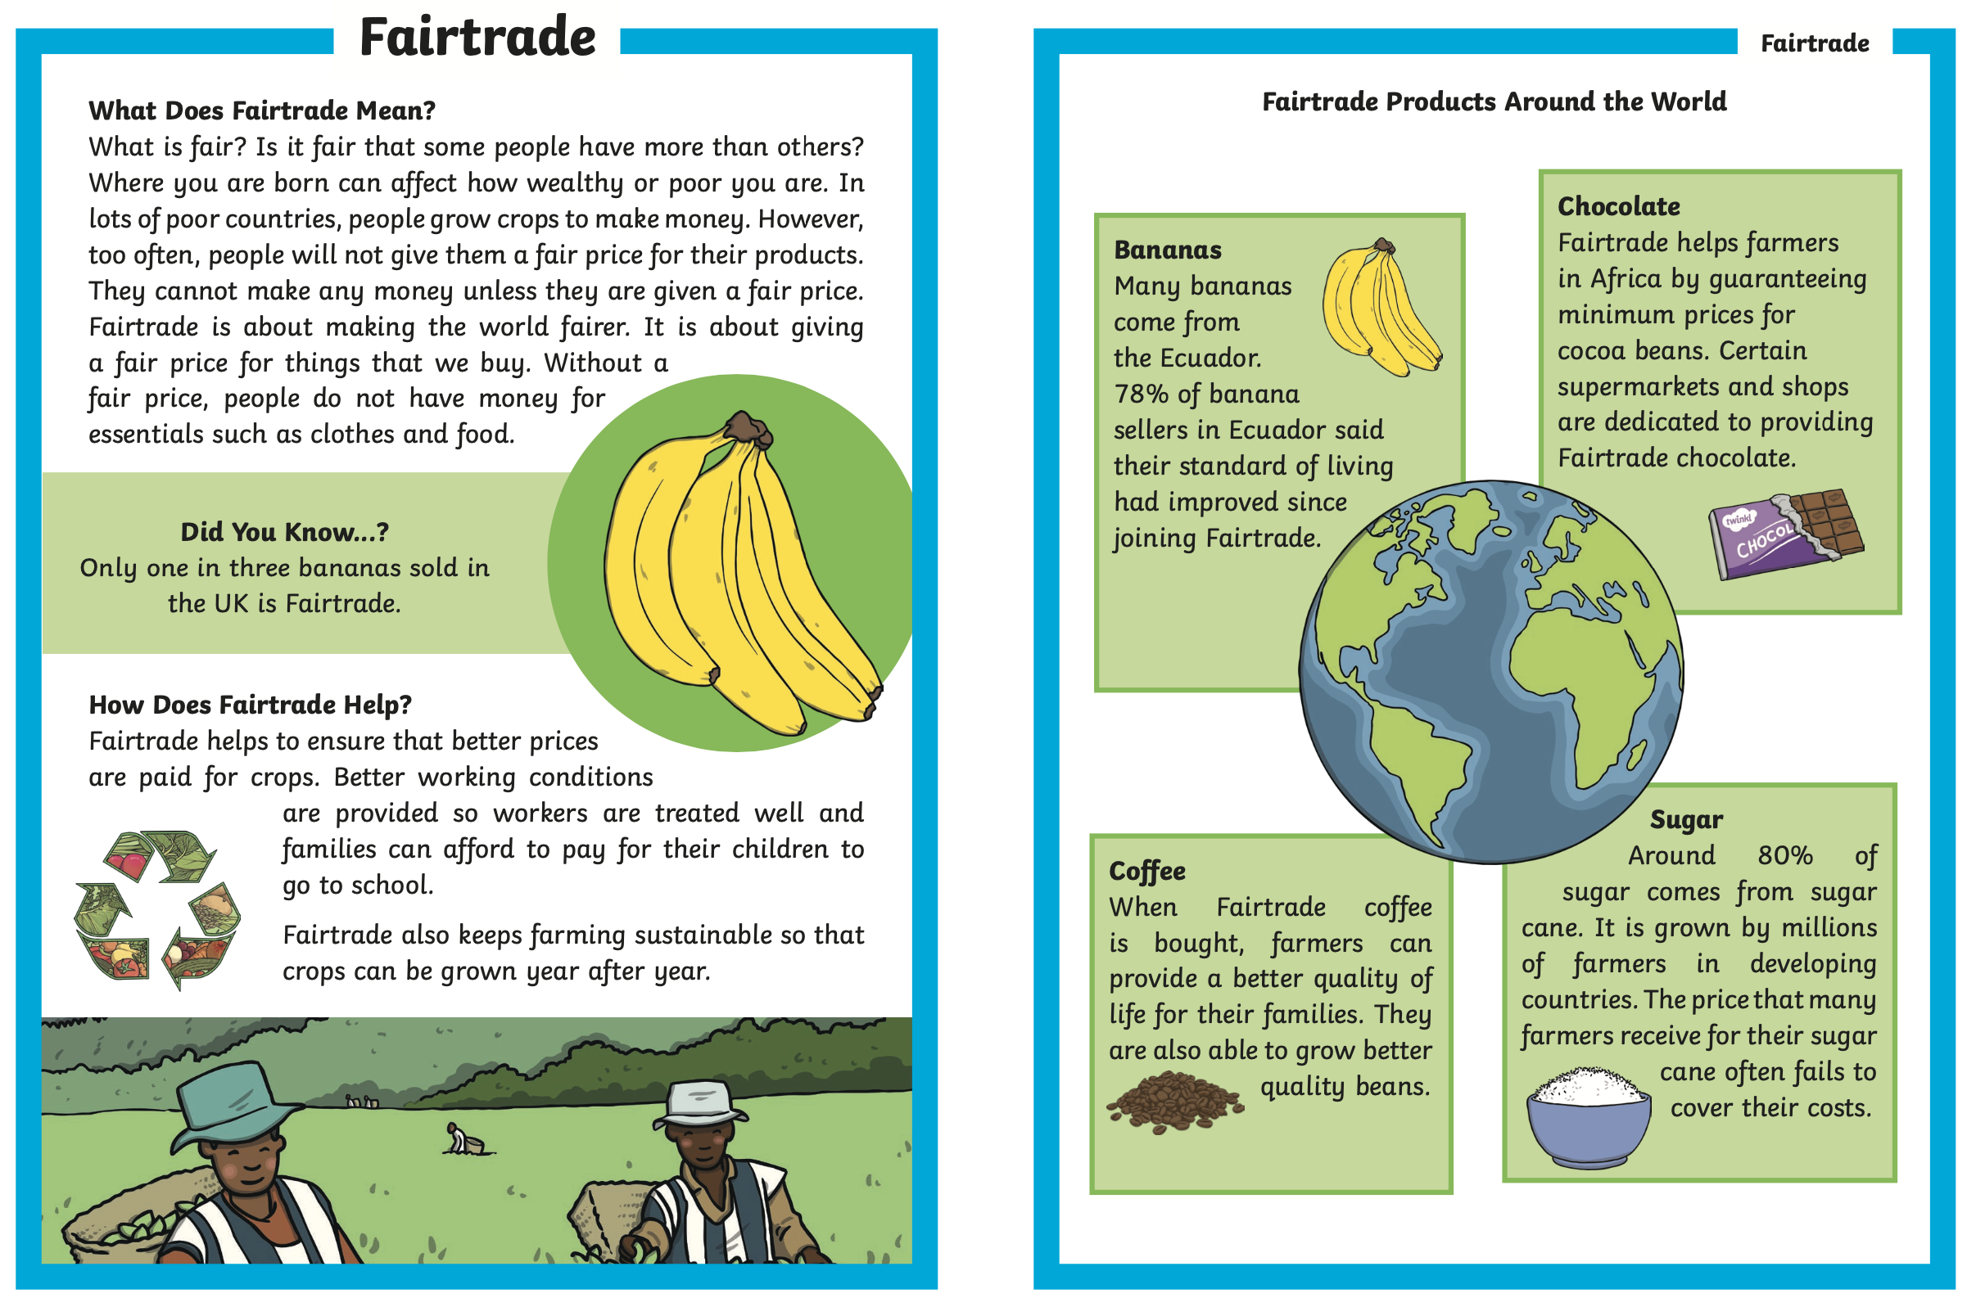
Reading Comprehension 3 Star Challenge

Slide 7
Challenge 2: Mind Map
Research information on Fairtrade.
Present your information in a Mind Map.
Remember to group your information systematically.
Remember to be creative when presenting your work. Add colours and pictures to improve your work.

Slide 8
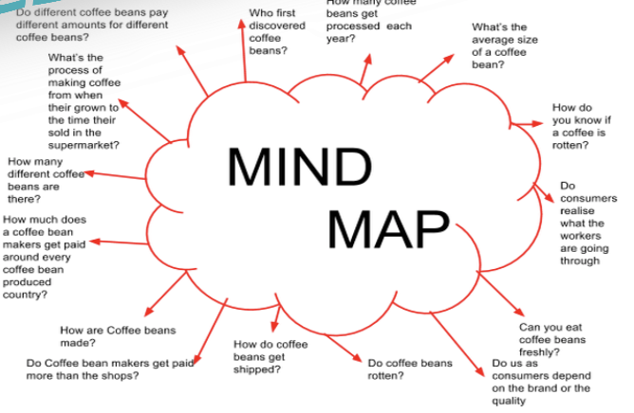
Example:
Mind Map
Coffee

Slide 9
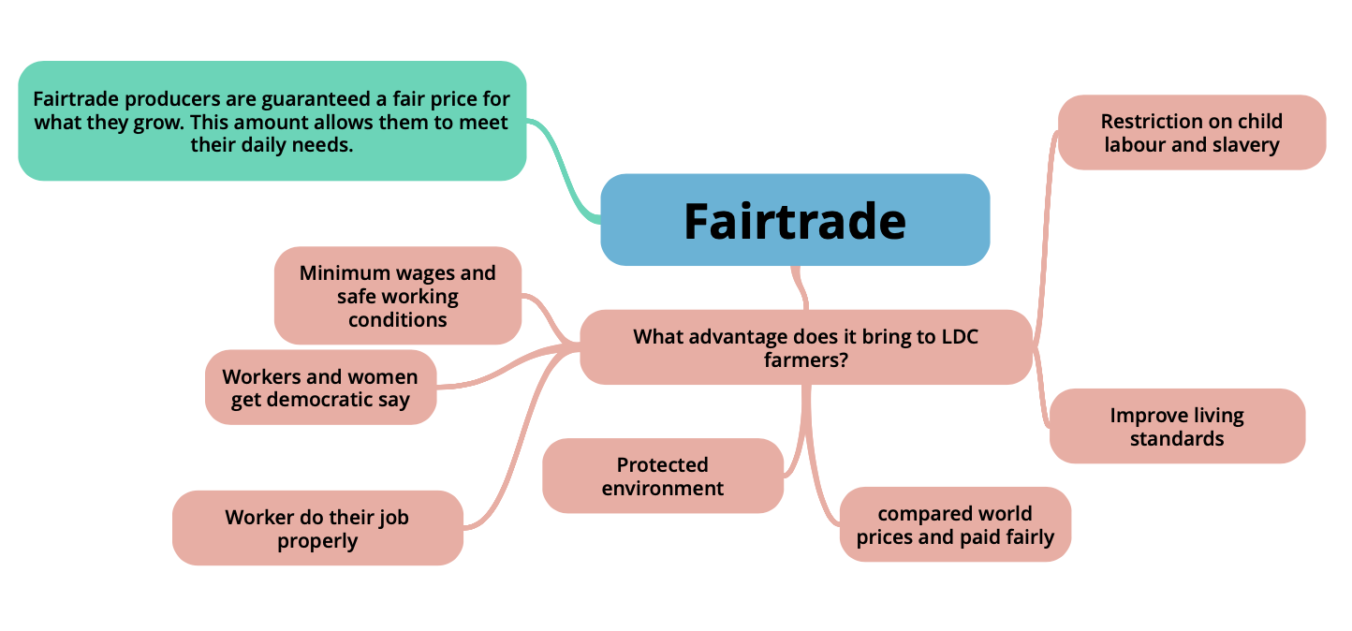
Example: Mind Map
FairTrade

Slide 10
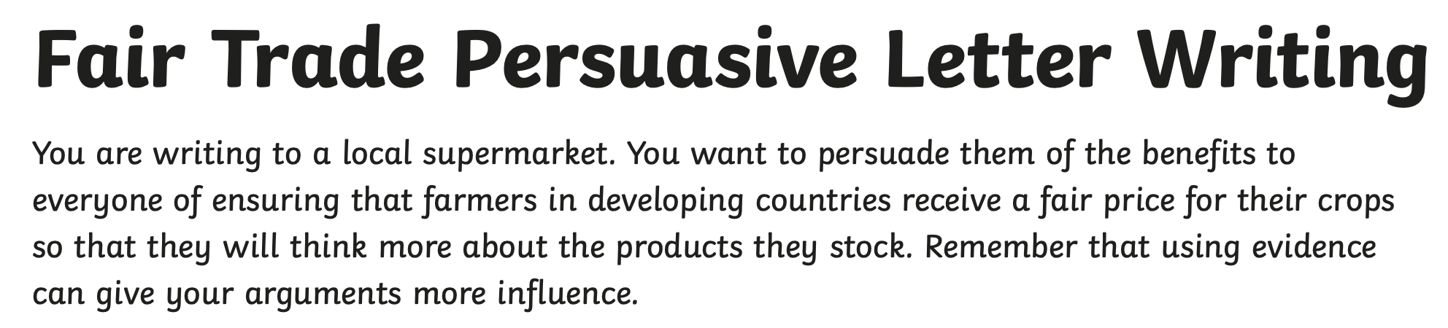
Challenge 3

Slide 11
Persuasive Writing
Features

Slide 12
Persuasion text
makes a case for a particular point of view
one or more points, perhaps with elaboration
*
*
*
Blank version

Slide 13
pamphlet from pressure group or political party
These texts are
often ‘persuasion text’…
advertisement
catalogue
travel brochure
persuasion
magazine article
“letter to the editor”
book blurb
poster or flier

Slide 14
Persuasion organisation 1
point
elaboration
*
point
*
elaboration
point
elaboration
*
…and so on……….

Slide 15
Persuasion organisation 2
Introduction
What? Who? Where? When?
When you have planned your points, you can choose whether to write one paragraph per point or group them together
*
Point 1
*
Point 2
*
Point 3
Conclusion
Summing up
Blank version

Slide 16
Persuasion language features
*
because
nevertheless
Present tense
consequently
*
Persuasive devices
however
As a result..
*
Logical connectives
If…then
*
Connectives showing the move from one point to another
First of all
then
next
secondly
finally

Slide 17
Audience
Purpose
Someone* who may not know much about the subject
To persuade them to your point of view (so they will.. do what?)
You have to
If you know what you want your audience to do as a result of reading your text it will help you plan what to say.
grab their attention
gain their trust
convince them you’re right.
* You may have further information about age, interests, etc. of reader

Slide 18
Elaborating a point
Make your point clearly, in a sentence.
elaboration would it help to:
*
give your reasons for thinking that?
point
give examples e.g For example,… For instance,…?
add further detail to make it clear?

Slide 19
Persuasive devices
*
emotive language
*
Rhetorical question
e.g ‘strong’ adjectives
“Are we expected to..?”
“How will..?”
deliberate ambiguity
*
e.g “probably the best”
*
Turning opinion into truth
perhaps, maybe
“The fact is..”
“The real truth is..”
*
“dare you to disagree!”
e.g Clearly,.. Surely,.. Obviously,..
Always ask yourself – is it …
FACT or OPINION?
Everyone knows that..

Slide 20
Challenge 3:
Decide on your level of challenge

Slide 21
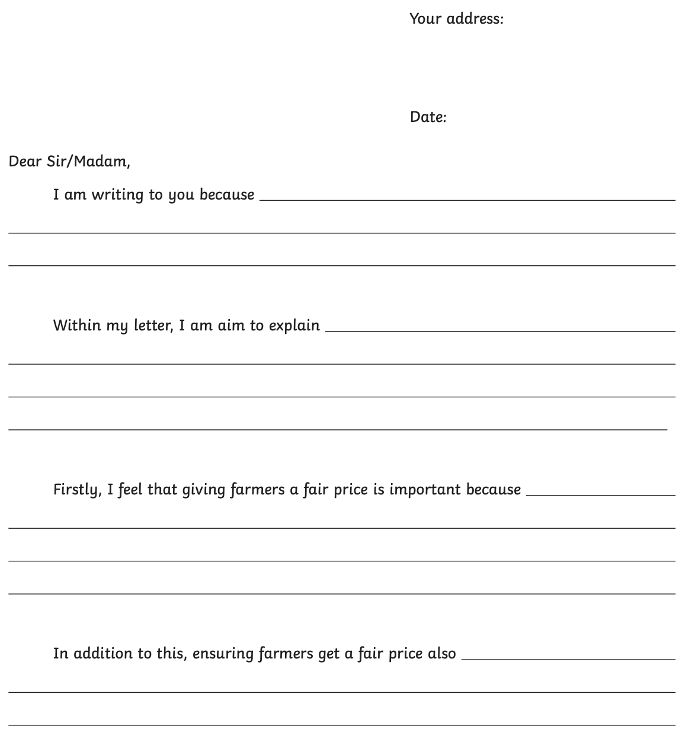
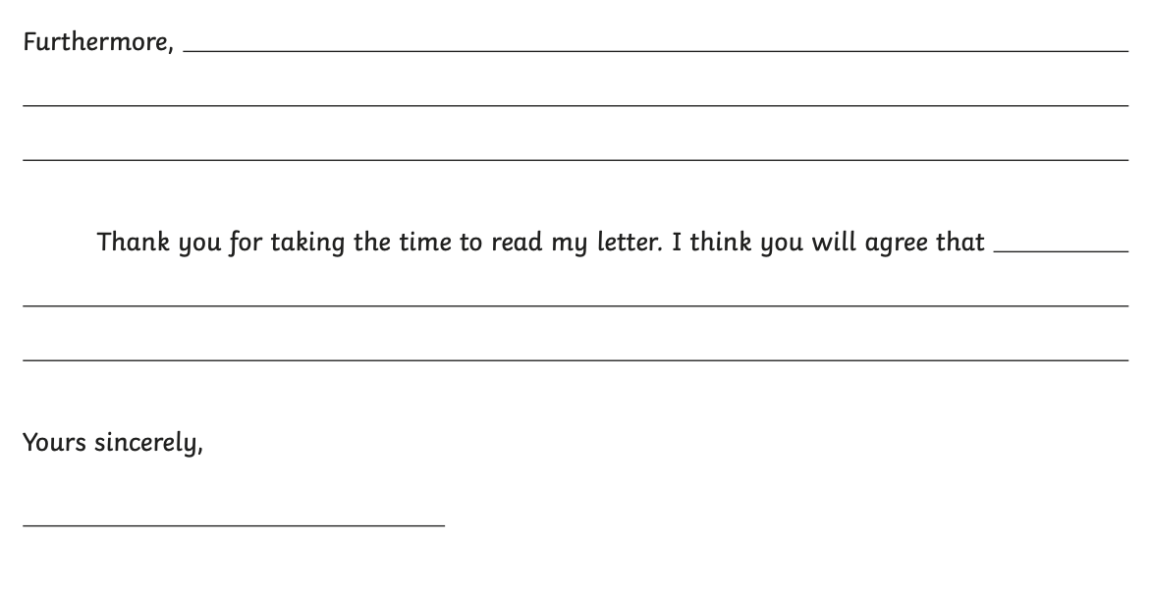
Challenge 3: 1 Star Challenge

Slide 22
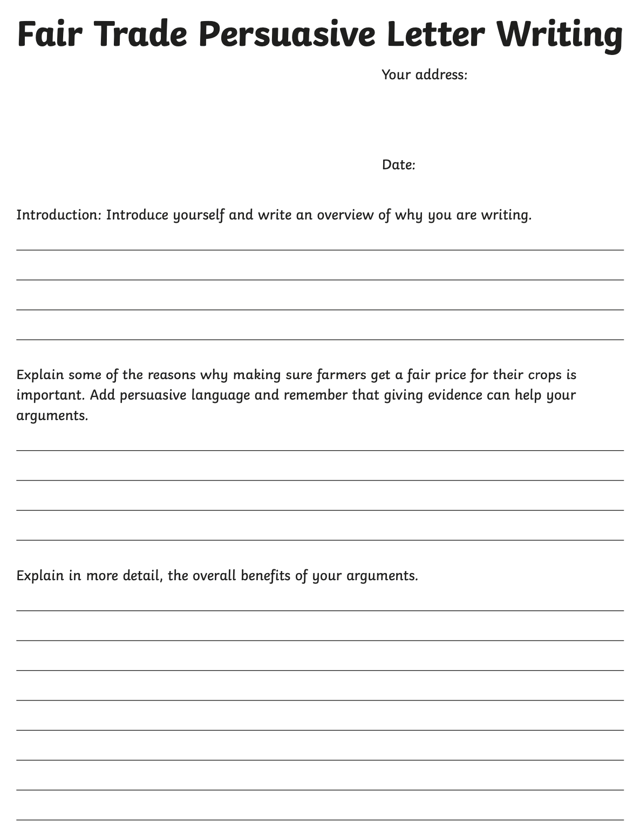
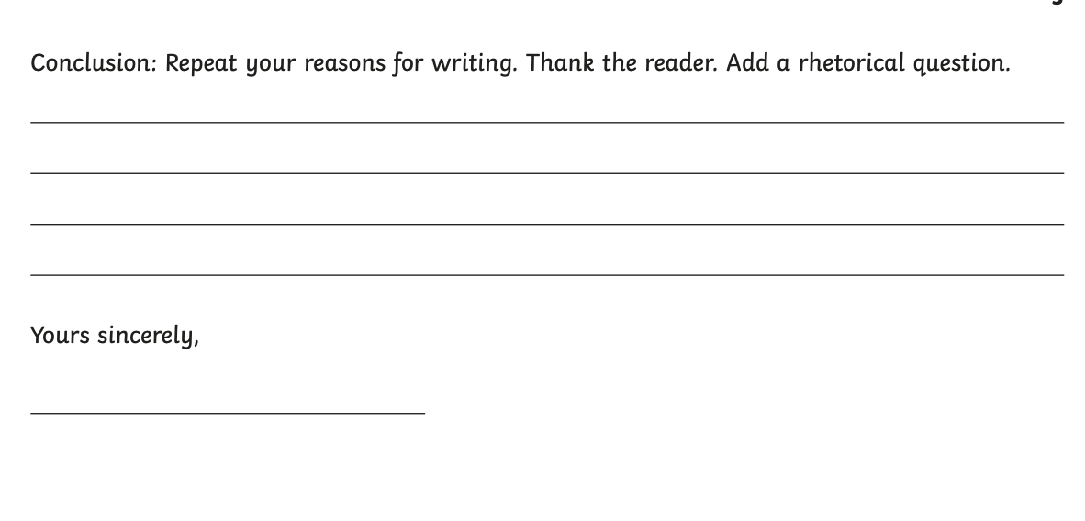
Challenge 3: 2 Star Challenge

Slide 23
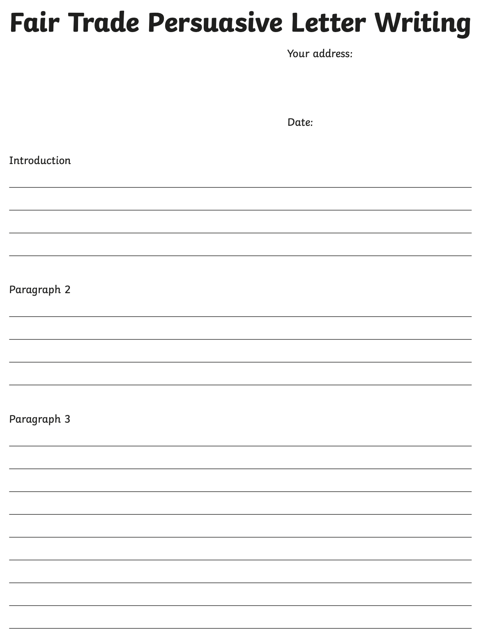
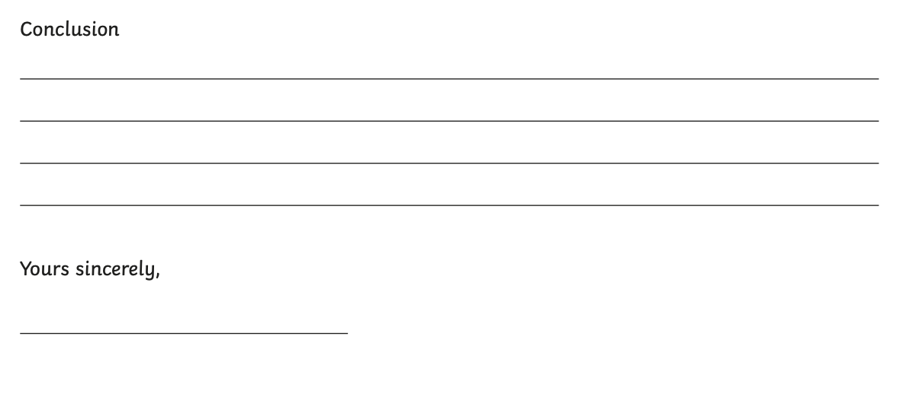
Challenge 3: 3 Star Challenge

