Slide 1
Mathematics & Numeracy / Humanities
Where Does Our Food Come From?

Slide 2

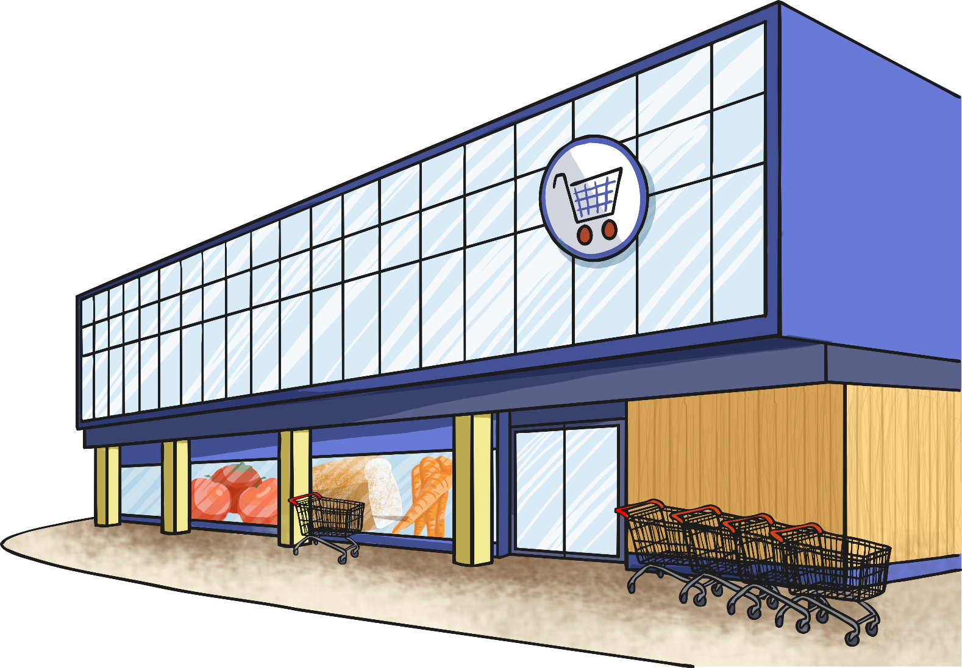

Where Does Our
Food Come From?
Where did all this
food come from?

Slide 3
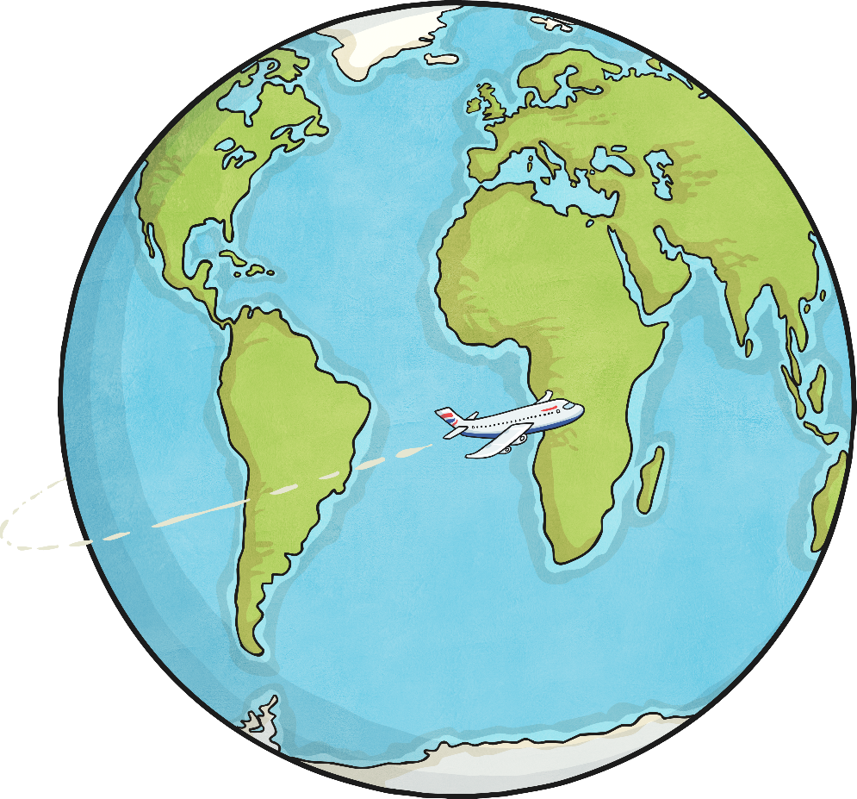
Food Miles
Food miles are the distance an item has travelled from where it was produced to where it was consumed, including all the miles in the supply chain process.
What do you think
food miles are?
We should worry about them because the further an item travels, the more CO2 is likely to be released into the atmosphere, contributing to climate change.
Why should we
worry about them?

Slide 4
Challenge 1

Slide 5

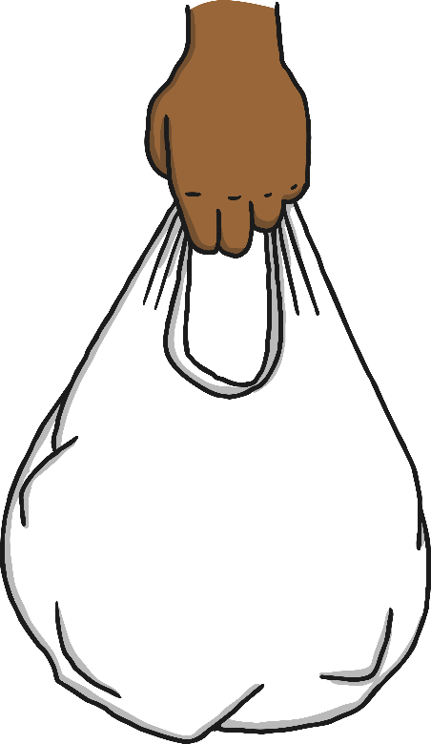
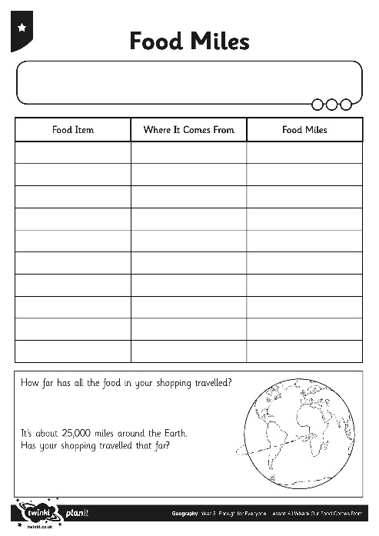
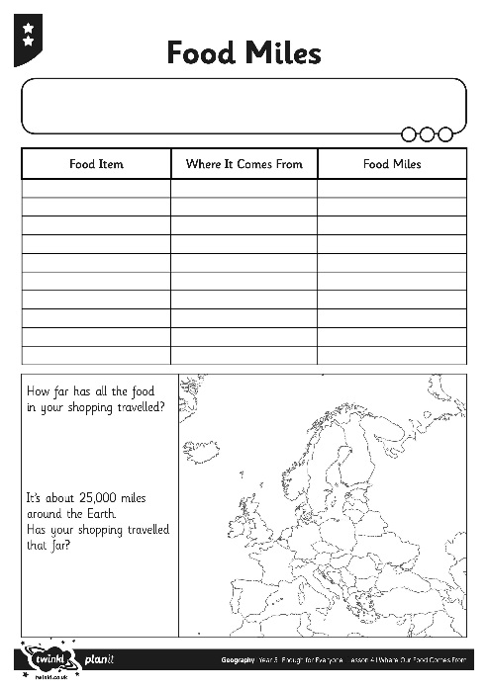
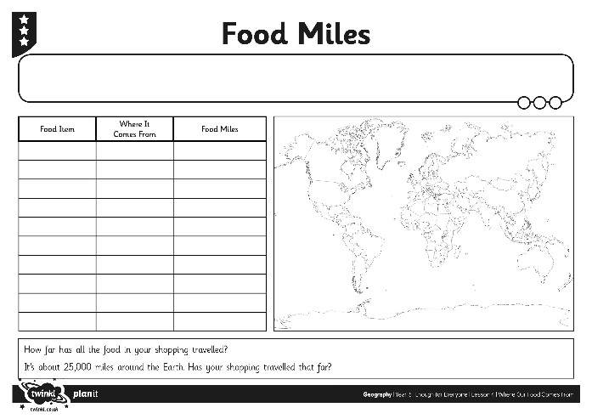
Calculating Food Miles
Look at
where each item
in your shopping bag came from.
Use this website to work out how far it has travelled to
our school as the crow flies
(that means in a straight line).

Slide 6
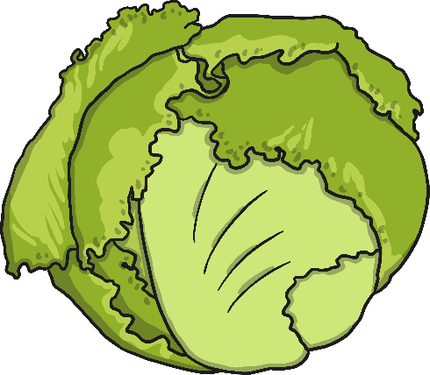
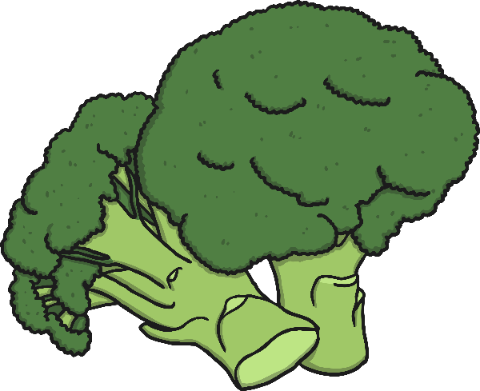
Does Fewer Miles Always Mean
Better for the Environment?
What do you think?
Are you surprised by this?
During the UK winter, lettuces in Spain are grown outside.
In the UK, lettuces are grown in the field in summer and in
greenhouses in winter.
Greenhouses use a lot of energy for heating and lighting – causing more CO2 than driving the lettuce by truck from Spain to the UK.
Fresh UK broccoli released less CO₂ than fresh Spanish broccoli, but freezing the UK broccoli increased the CO₂ to the same level as the Spanish produce.

Slide 7

What Are the Benefits
of Importing Food?
Importing foods means we have a varied, healthy diet so people get less ill.
Importing food protects us against the effect of a poor UK harvest.
Importing food
provides a market for foreign farmers’ produce, boosting the foreign economies.
Importing foods
means supermarkets can negotiate lower prices, which means we pay less for our food.
Foods that only grow
in certain seasons in
the UK are available
all year round.

Slide 8

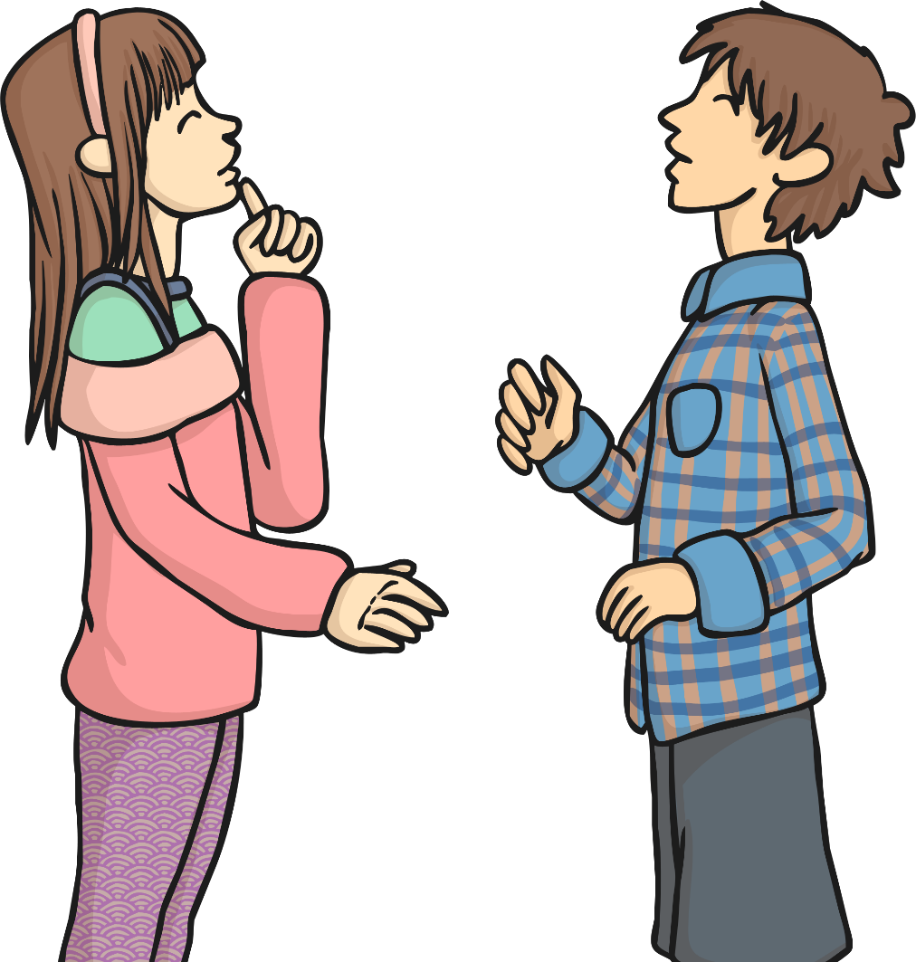
What Do You Think?
Should we import
food from abroad?
What are the benefits?
What are the risks?

Slide 9
Challenge 2

Slide 10

Choose 4, 6 0r 8 food items from challenge 1.
Order the distance from the shortest to the longest.
Order the distance from the shortest to the longest. Work out the difference between the longest and shortest distance.
Order the distance from the longest to the shortest. Work out the difference between the longest and the shortest distance. Can you convert this
distance into Kilometers (km)
This Photo by Unknown Author is licensed under CC BY-SA
This Photo by Unknown Author is licensed under CC BY-SA

Slide 11
Challenge 3

Slide 12
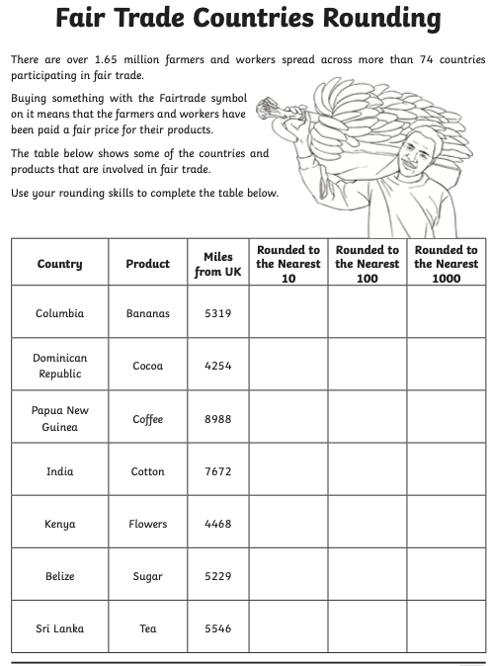
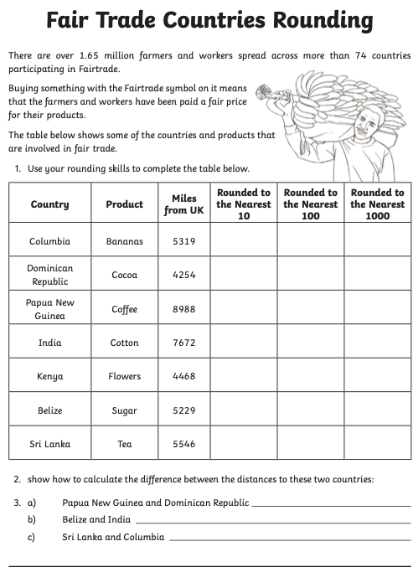
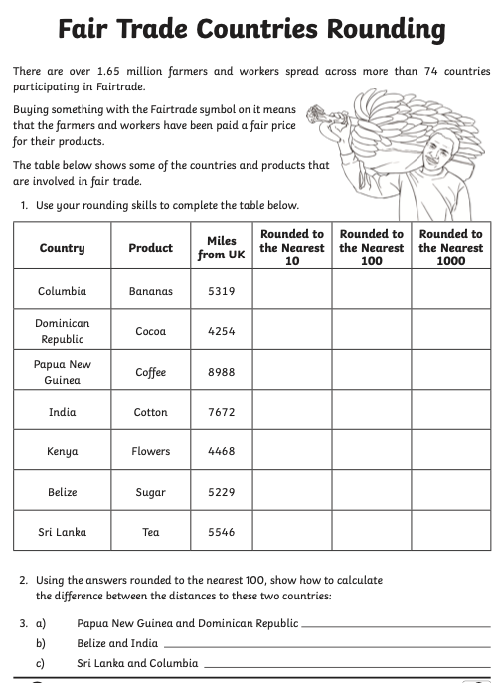
There are over 1.65 million farmers and workers spread across more than 74 countries participating in Fairtrade.
Use your rounding skills to complete the following challenge. Remember anything which is 5 or over you round up. 4 or below you round down.

