Slide 1
Expressive Arts
Poster

Slide 2

Challenge
Design a poster that will support Fairtrade.
Use the information that you have gained from the comprehension and letter to help you include the relevant information.
You want to persuade the public of the benefits to everyone of ensuring that farmers in developing countries receive a fair price for their crops so that they will think more about the products that they stock and purchase Fairtrade products when possible.
Use J2e5 to create your poster

Slide 3
Tips…

Slide 4
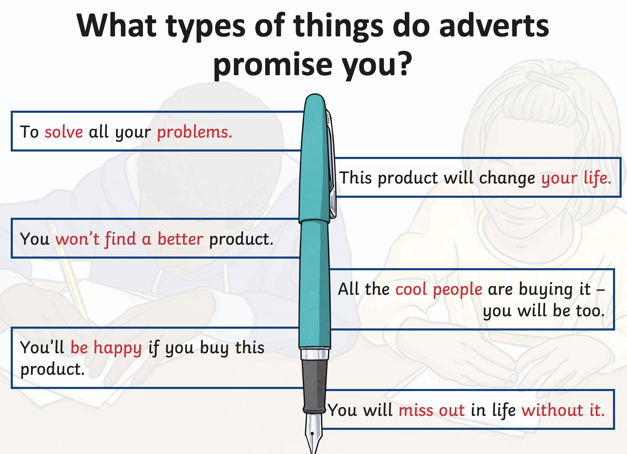

Slide 5
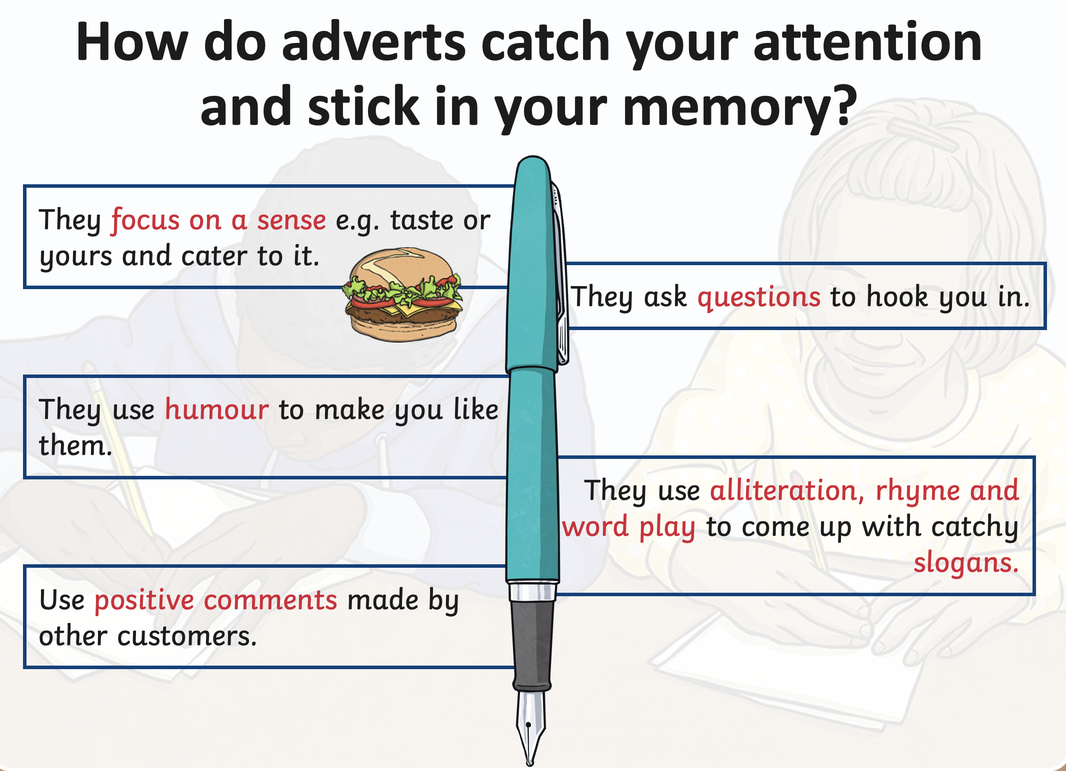

Slide 6
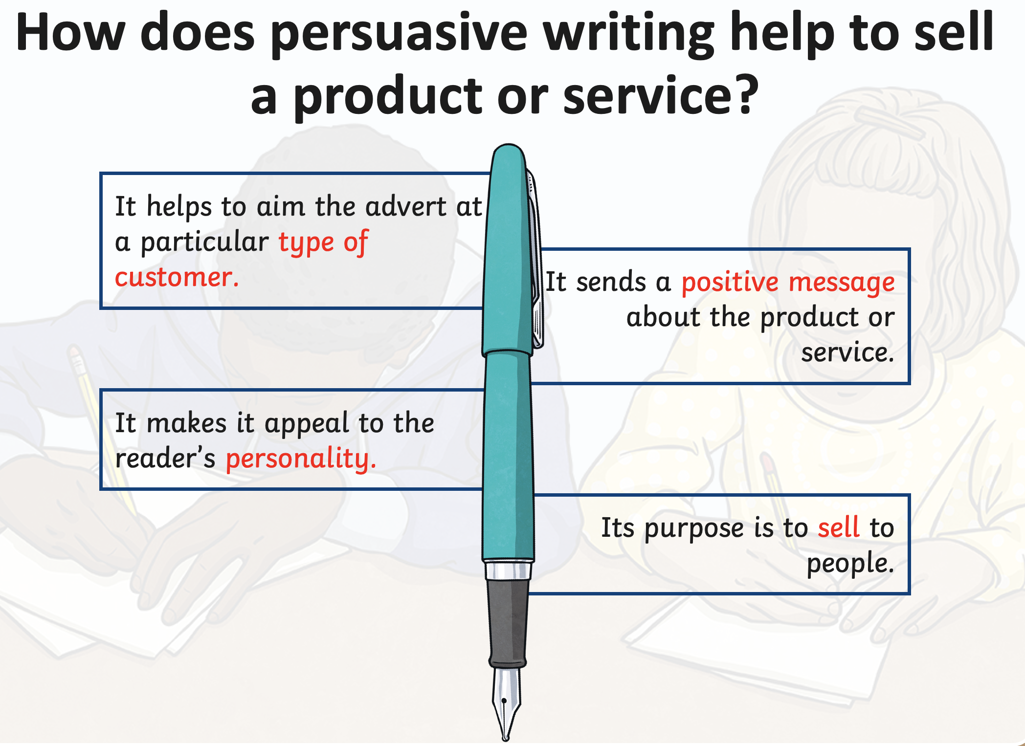

Slide 8
Examples of Fairtrade Posters

Slide 9


Slide 10


