Slide 1
Instructional Writing
Week 7
22.02.2021 – 26.02.2021

Slide 2

Aims
I can identify the features of an instruction text.
I can write instructions.

Slide 3
Challenges:
Challenge 1:
Decide on your level of challenge and complete the work on imperative verbs.
Challenge 2: How to Care for a Mouskin
Read the instructions on how to care for a mouskin. Record yourself reading the text and add it to your LLC folder. What features of an instruction text can you spot? Number the features that you can find following the guide on page 14 and 15 of this powerpoint.
Challenge 3:
Write a recipe on how to make a cake of your choice. Think carefully about how you will set out your work.

Slide 4

Instructions
Instructions tell us how do to something.
There are many different types of instructions. Some examples include:
recipes;
directions;
how to play a game;
how to make or build something;
how to repair something;
or how to look after/care for something.
Can you think of any more examples?

Slide 5
Features of Instruction Writing
Regardless of their purpose, instructions share many of the same features:
An introduction to explain what the end result will be (what the instructions will help the reader to do). This will usually include questions to engage the reader.
A list of things the reader will need, such as ingredients for a recipe, materials for a building project or equipment for a craft activity.
An outline of the method needed to complete the task (usually in chronological order).

Slide 6
Features of Instruction Writing
Imperative verbs are usually used within the method to ‘boss’ the reader around!
Conjunctions, prepositions and adverbs to show time, place and cause should be used throughout, e.g. After that, Inside the box, As soon as it has melted, etc.
Extra tips and advice may be given to the reader for especially tricky parts of a task.
Pictures or diagrams can be used to provide clarification, e.g. a series of pictures or diagrams corresponding to each step of the method, a single picture or diagram of a tricky part of the process or an illustration of the final product.

Slide 7

Features of Instruction Writing
Pictures or diagrams can be used to provide clarification, e.g. a series of pictures or diagrams corresponding to each step of the method, a single picture or diagram of a tricky part of the process or an illustration of the final product.
A conclusion to sum up the task and help the reader check that they have achieved the correct outcome.
Layout devices will also be used to structure and organise the text. These may include headings and subheadings, underlining, bold or italic text, bullet points and numbers.

Slide 8
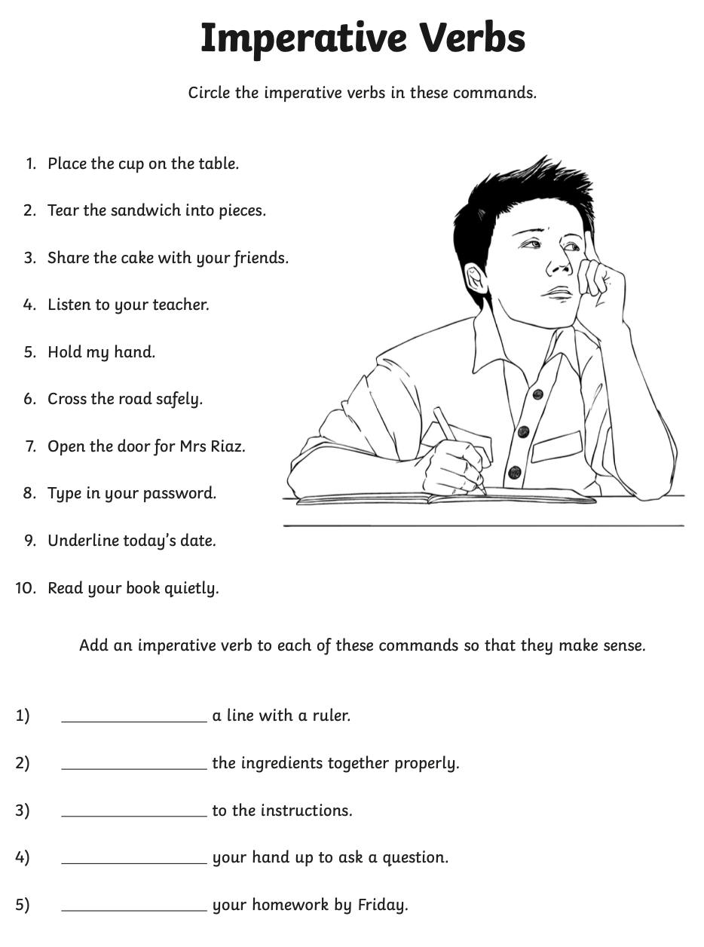

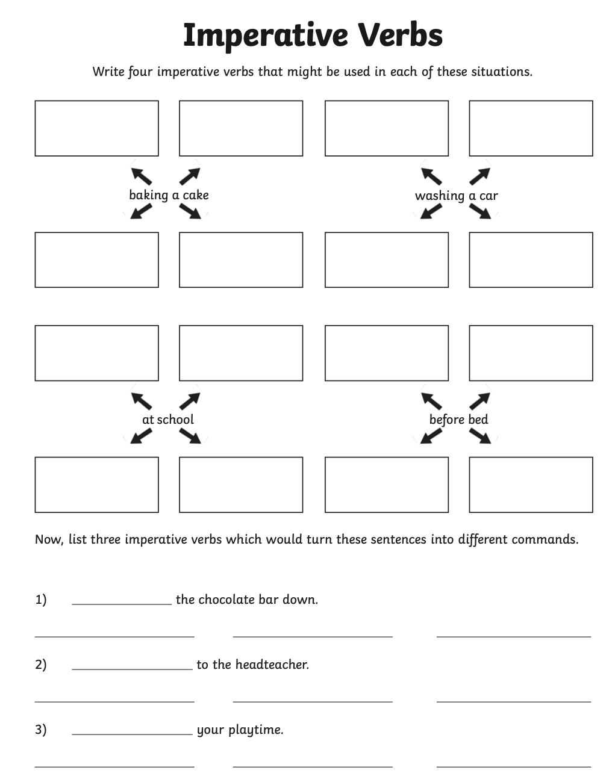
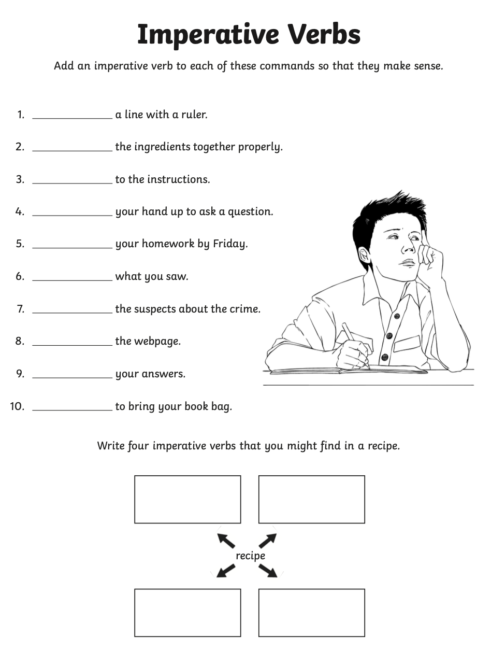
Challenge 1: Decide on your level of challenge and complete the work on imperative verbs.

Slide 9
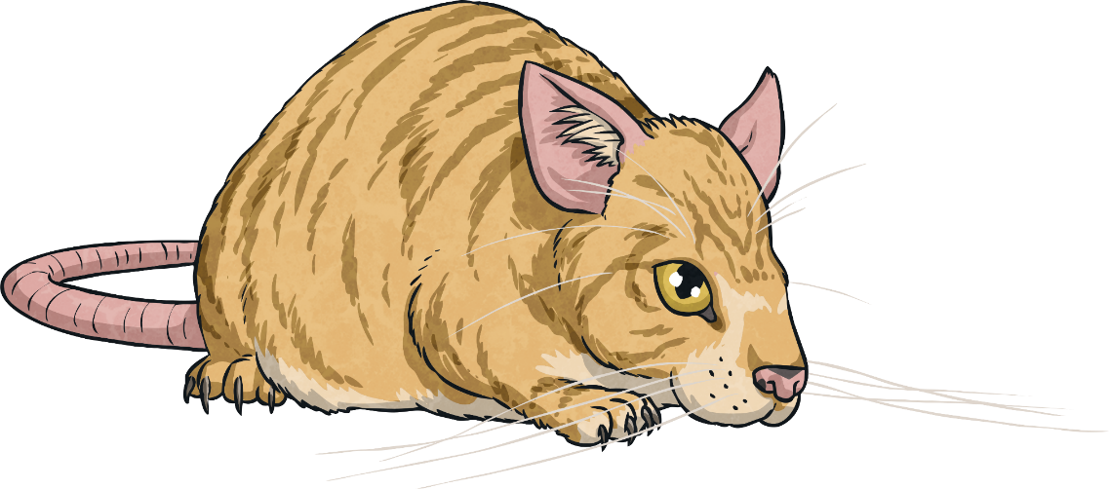
Challenge 2: How to Care for a Mouskin
Read the instructions on how to care for a mouskin.
Record yourself reading the text and add it to your LLC folder.
What features of an instruction text can you spot?
Number the features that you can find following the guide on page 14 and 15 of this powerpoint.

Slide 10
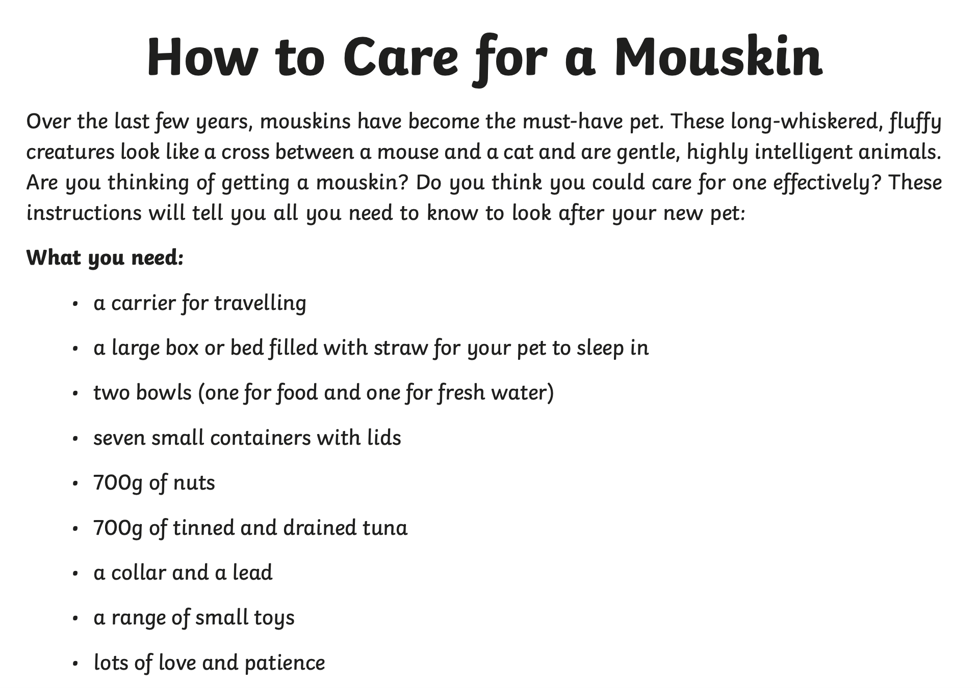

Slide 11
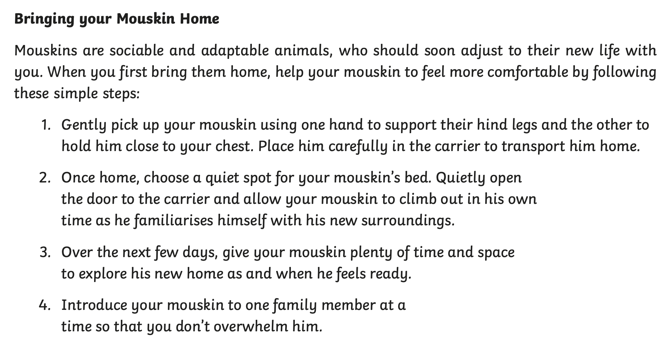

Slide 12
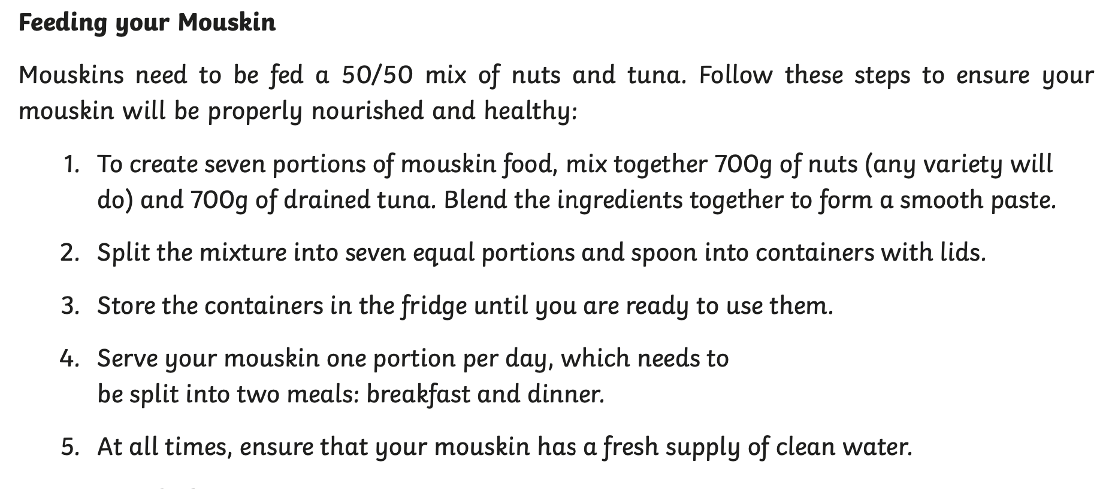

Slide 13
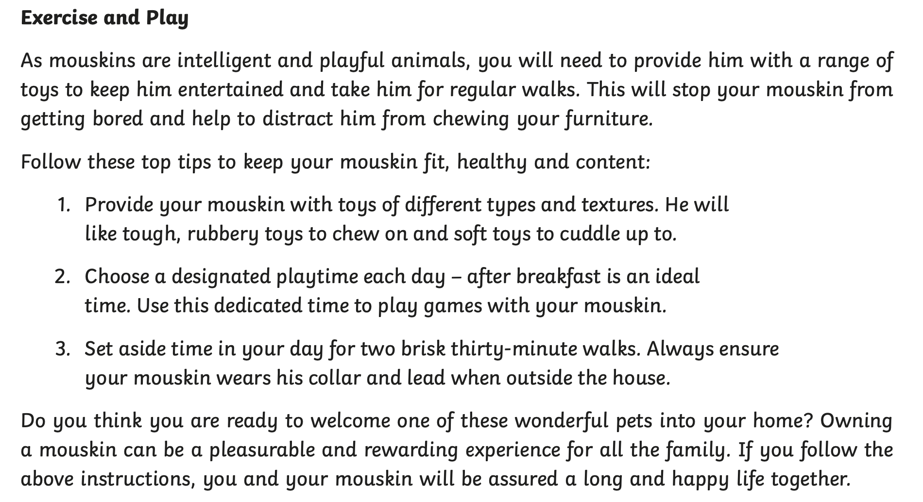

Slide 14
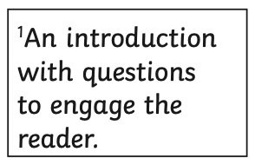
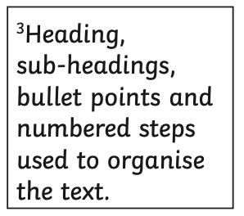

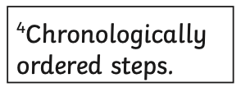
Can you find and number in the text example?

Slide 15

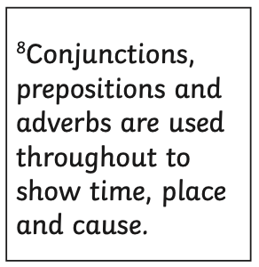
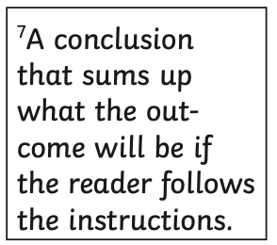
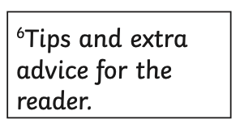
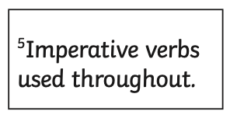
Can you find and number In the text example?

Slide 16
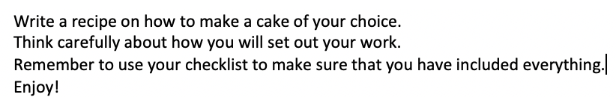
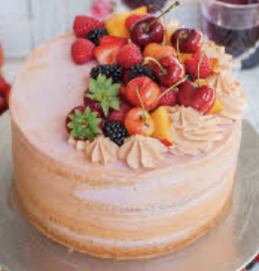
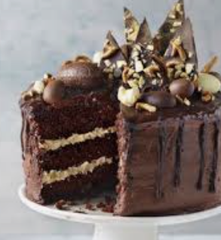
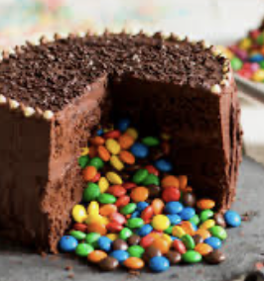
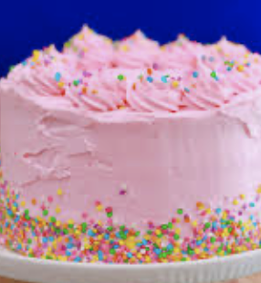
Challenge 3:

Slide 17
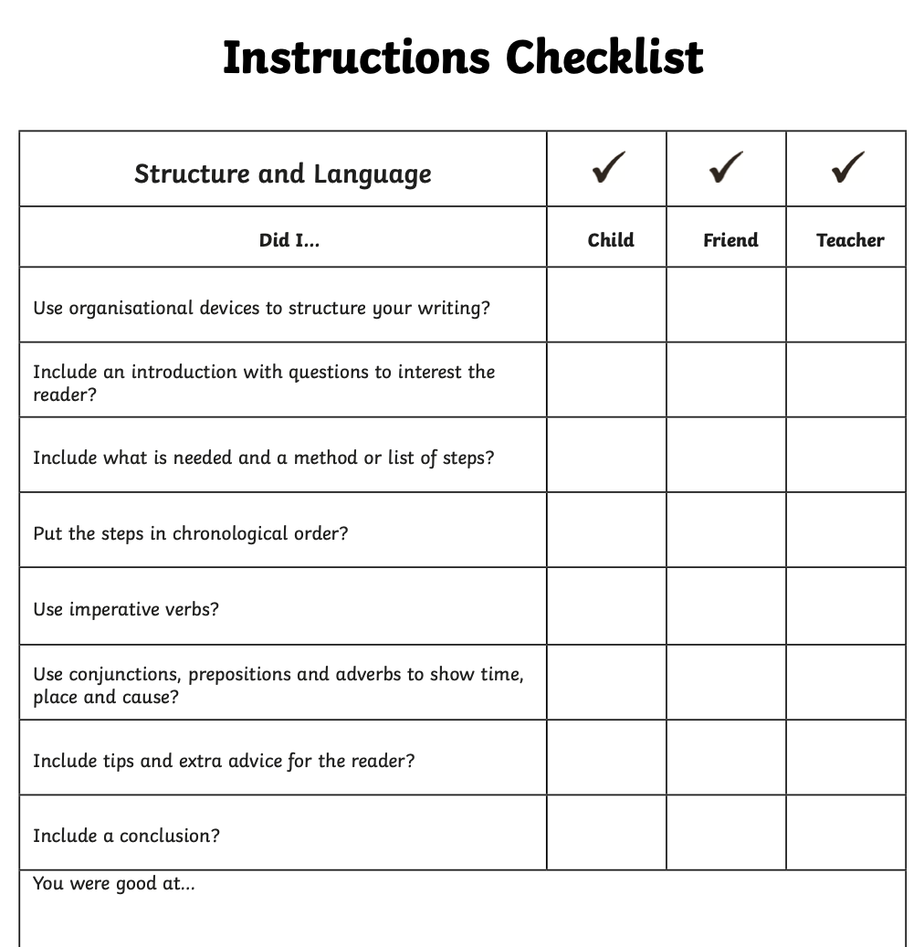

Slide 18


