Slide 1
Symmetry

Slide 2

Is It a Reflection?
Is this reflection correct?
This reflection is correct!
Show Answer

Slide 3
Is It a Reflection?
Is this reflection correct?
This reflection is correct!
Show Answer

Slide 4
Is It a Reflection?
Is this reflection correct?
This reflection is correct!
Show Answer

Slide 5
Reflecting Shapes in a
Mirror Line
The reflected image is congruent to the original. This means that the measurements of the sides and angles have not changed.
When a shape is reflected in a mirror line, it is flipped over.
Each point of the reflected shape is the same distance from the mirror line as the original shape.
90°
90°

Slide 6
Drawing a Reflected Shape
When asked to draw the new position of a 2D shape after a reflection, we have to make sure that each corner of the reflected shape is the same distance from the mirror line.
1 square to the left of the mirror line
1 square to the right of the mirror line
First identify the distance of a corner from the mirror line on the original shape.
Then apply this to the opposite side of the mirror line.
Repeat this process with each corner.

Slide 7
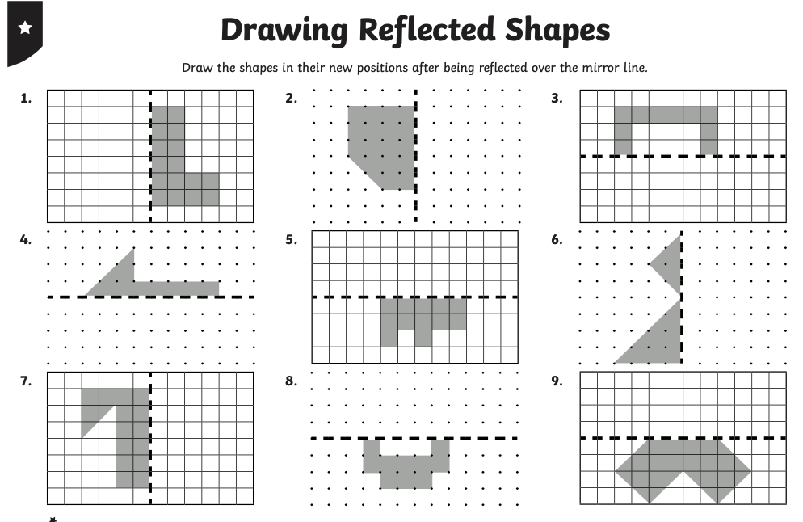
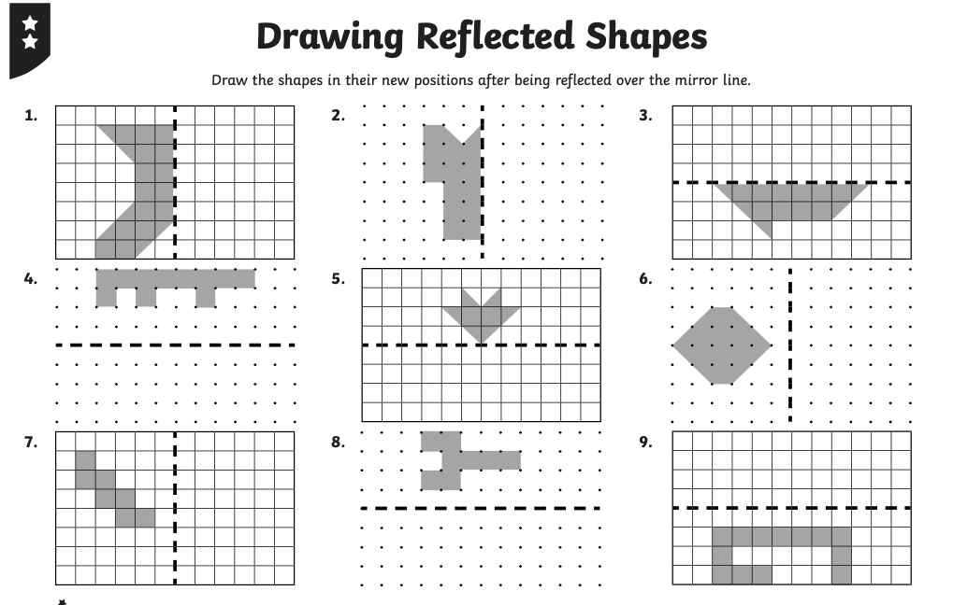
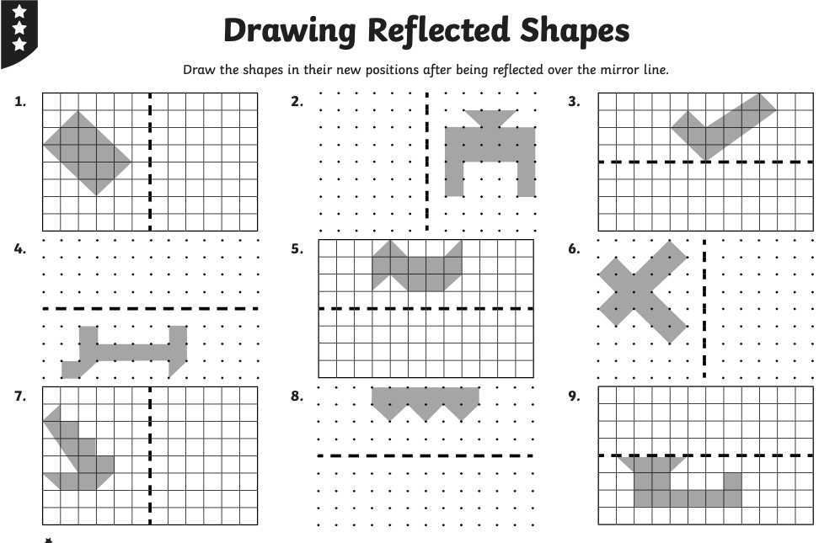
Challenge 1

Slide 8

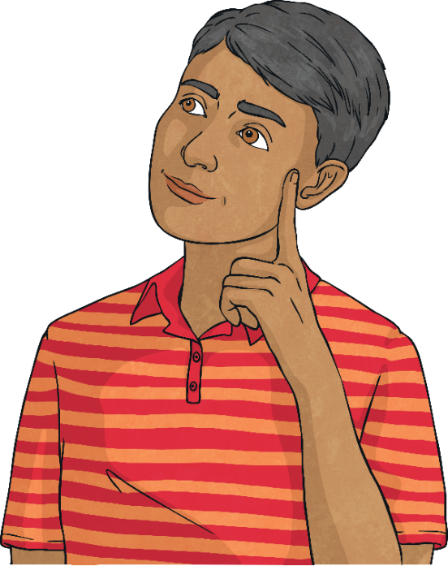
Reflection
Deeper
Jack is reflecting a triangle in two perpendicular mirror lines.
Where has he made a mistake? What should this triangle look like? Draw on your white board.
The highlighted triangle was incorrect.
It should look like this if it has been reflected correctly.

Slide 9

Reflection
Deepest
You might have noticed that only regular polygons with an even number of sides look identical when reflected across two perpendicular mirror lines.

Slide 10
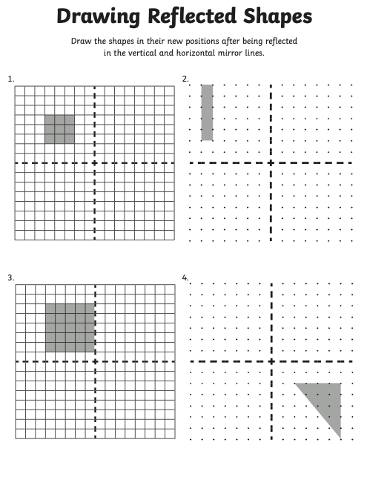
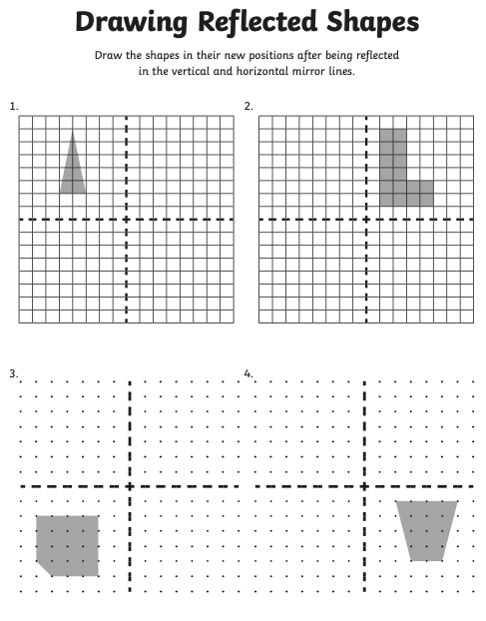
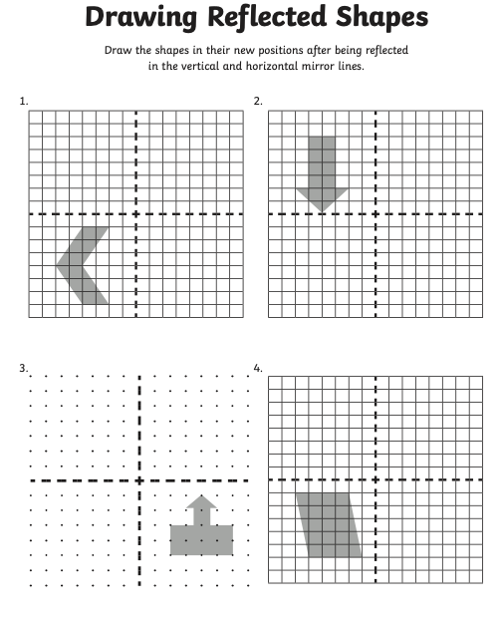
Challenge 2

Slide 11
Challenge 3
For the 3rd challenge we would like you to draw your own picture showing an example of any type of symmetry. Remember to add detail to your drawings, making sure they are symmetrical.
Be creative and enjoy.

