Slide 1

LLC Explanation Text
Week 4 25.01.2021 – 29.01.2021

Slide 2
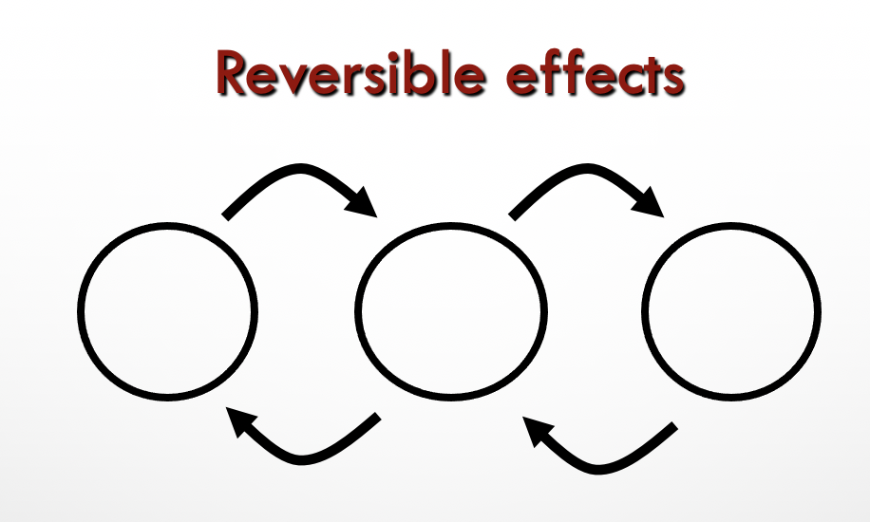


Challenges
Challenge 1:
Identify the features of an Explanation Text
Challenge 2:
Read the example Explanation Text ‘How do materials change state?’ carefully. Complete the skeleton on page 20.
Find the features from the Genre Checklist in the explanation text ‘How do materials change state?’.
Challenge 3:
Write and explanation text on how rainbows are made.
(Link to Science and Technology Challenge)

Slide 3
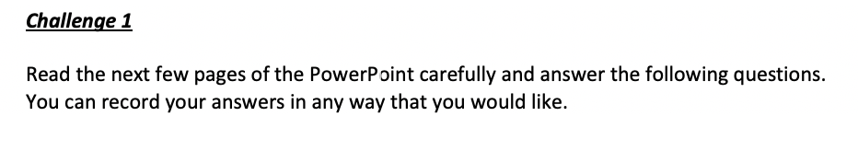
Give examples of when you would use or read an explanation text?
Why would you write an explanation text?
What are the main features of an explanation text?
Write five examples of ‘ Causal Language’
Write five examples of Time / sequential connectives

Slide 4
explanation text
* explains how or why something happens
* cause and effect
* often in time order
(sequential)
Blank version

Slide 5
These texts are
often ‘explanation text’…
“question & answer” articles and leaflets
encyclopaedia entry
parts of a non-fiction book
explanation
(e.g geography, biology)
write-up of science experiment
science text book
technical manual
(e.g for car or washing machine)

Slide 6
explanation organisation 1
Simple explanation: a series of logical steps
Probably… labelled diagram(s)
This happens
this
this
this
leading to
leading to
leading to
When you have made your flow-chart skeleton, each section of the flow chart can become one paragraph or section of writing.
possibly---other causes or effects at each stage

Slide 7
explanation language features
* present tense (except historical explanations)
If…then…
because
The reason that
* causal language
when
so
* sequential connectives
This results in…
* impersonal language (see page 8)
This causes…
Therefore
* technical vocabulary

Slide 8
Audience
someone* who wants to understand a process (how or why)
Purpose
to help reader understand the process as easily as possible
clear layout
use of labelled diagrams possible use of colour-coding, keys, etc.
use of boxes for extra information
* You may have further information on the age, interests, etc of readers.

Slide 9
impersonal language
* third person
The stick was placed in…
* passive voice
* usually formal vocabulary
This is known as…
(e.g “placed” as opp “put”, “known as” as opp. “called”)
The motor is operated by…
* formal connectives
The sides are covered in…
(e.g Furthermore, However, Therefore, Consequently)

Slide 10

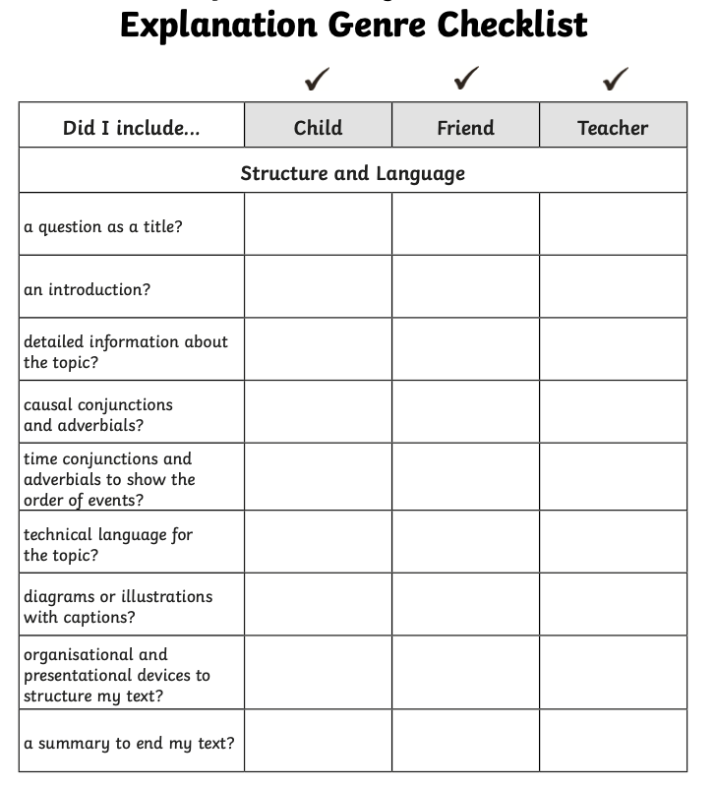
Explanation Genre Checklist
Remember to include…
Here is a tick list to help you see what you would need to include when writing an explanation text.

Slide 11
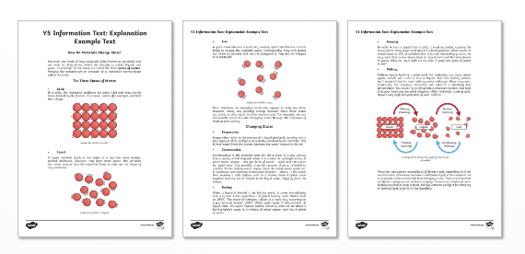
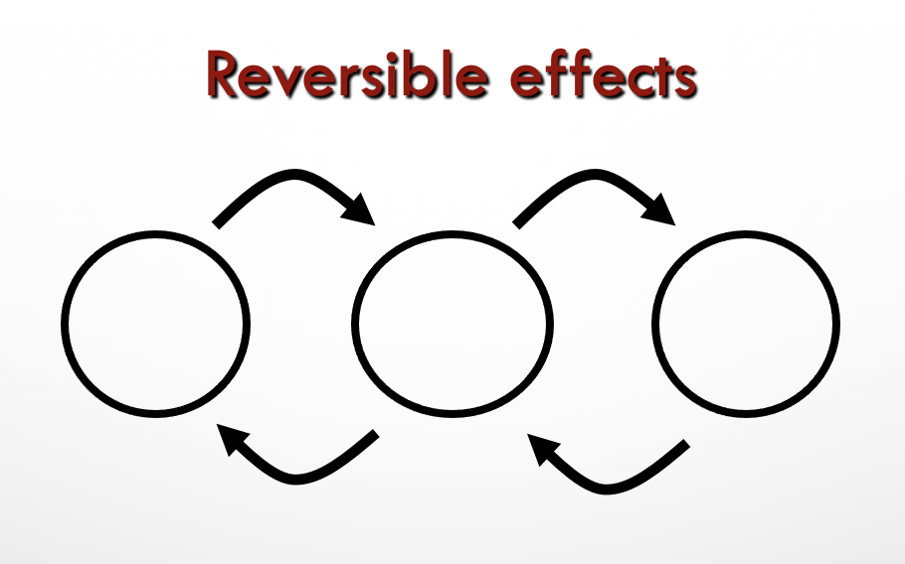
Challenge 2
Here is an Explanation Text Example ‘How do Materials Change State’.
Read the Explanation Text carefully and then complete the skeleton on page 21.
Find the features from the Genre Checklist in the explanation text ‘How do materials change state?’.

Slide 12
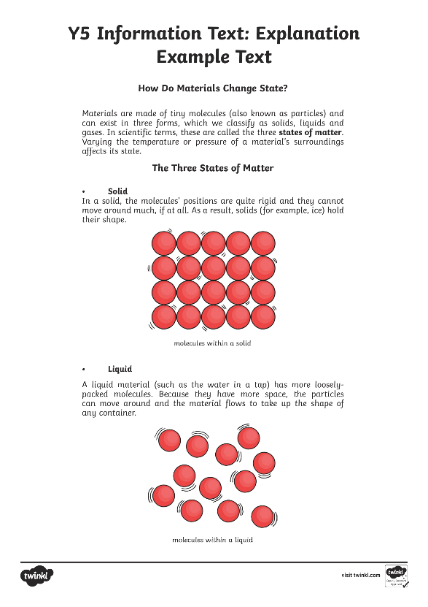
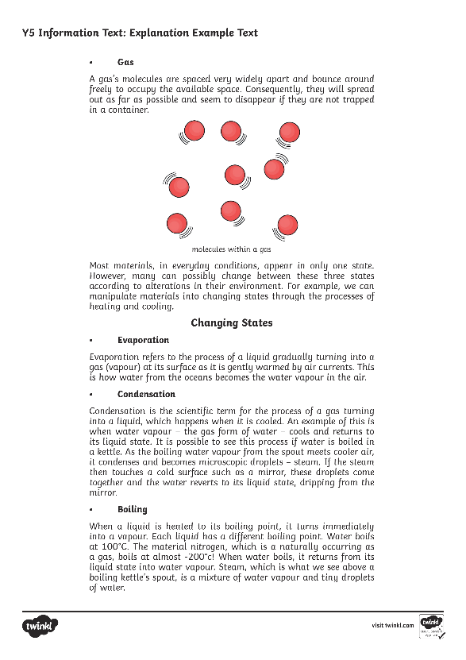
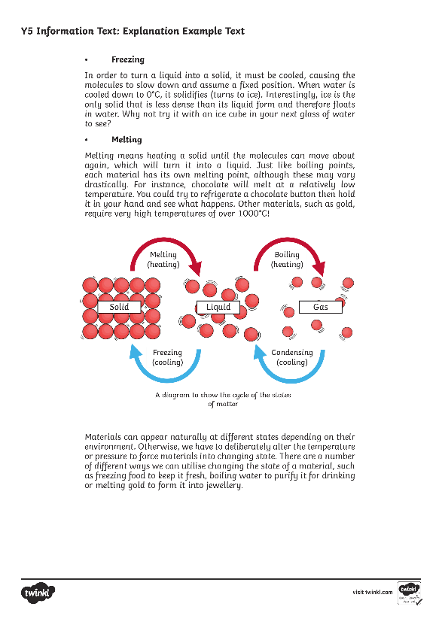

Slide 13
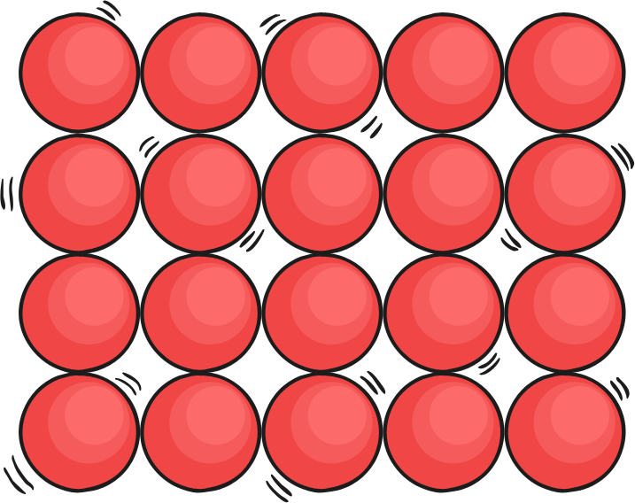
How Do Materials Change State?
Materials are made of tiny molecules (also known as particles) and can exist in three forms, which we classify as solids, liquids and gases. In scientific terms, these are called the three states of matter. Varying the temperature or pressure of a material’s surroundings affects its state.
The Three States of Matter
• Solid
In a solid, the molecules’ positions are quite rigid and they cannot move around much, if at all. As a result, solids (for example, ice) hold
their shape.
molecules within a solid

Slide 14
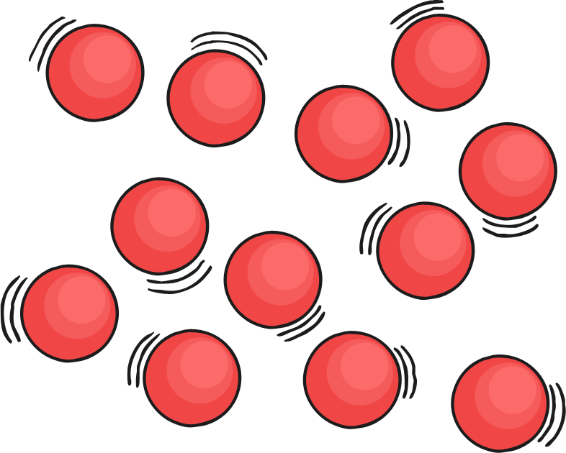
• Liquid
A liquid material (such as the water in a tap) has more loosely-packed molecules. Because they have more space, the particles can move around and the material flows to take up the shape of any container.
molecules within a liquid

Slide 15
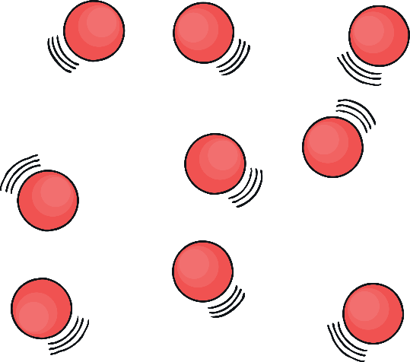
• Gas
A gas’s molecules are spaced very widely apart and bounce around freely to occupy the available space. Consequently, they will spread out as far as possible and seem to disappear if they are not trapped in a container.
molecules within a gas
Most materials, in everyday conditions, appear in only one state. However, many can possibly change between these three states according to alterations in their environment. For example, we can manipulate materials into changing states through the processes of heating and cooling.

Slide 16
Changing States
• Evaporation
Evaporation refers to the process of a liquid gradually turning into a gas (vapour) at its surface as it is gently warmed by air currents. This is how water from the oceans becomes the water vapour in the air.
• Condensation
Condensation is the scientific term for the process of a gas turning into a liquid, which happens when it is cooled. An example of this is when water vapour – the gas form of water – cools and returns to its liquid state. It is possible to see this process if water is boiled in a kettle. As the boiling water vapour from the spout meets cooler air, it condenses and becomes microscopic droplets – steam. If the steam then touches a cold surface such as a mirror, these droplets come together and the water reverts to its liquid state, dripping from the mirror.

Slide 17
• Boiling
When a liquid is heated to its boiling point, it turns immediately into a vapour. Each liquid has a different boiling point. Water boils at 100°C. The material nitrogen, which is a naturally occurring as a gas, boils at almost -200°C! When water boils, it returns from its liquid state into water vapour. Steam, which is what we see above a boiling kettle’s spout, is a mixture of water vapour and tiny droplets of water.
• Freezing
In order to turn a liquid into a solid, it must be cooled, causing the molecules to slow down and assume a fixed position. When water is cooled down to 0°C, it solidifies (turns to ice). Interestingly, ice is the only solid that is less dense than its liquid form and therefore floats in water. Why not try it with an ice cube in your next glass of water to see?

Slide 18
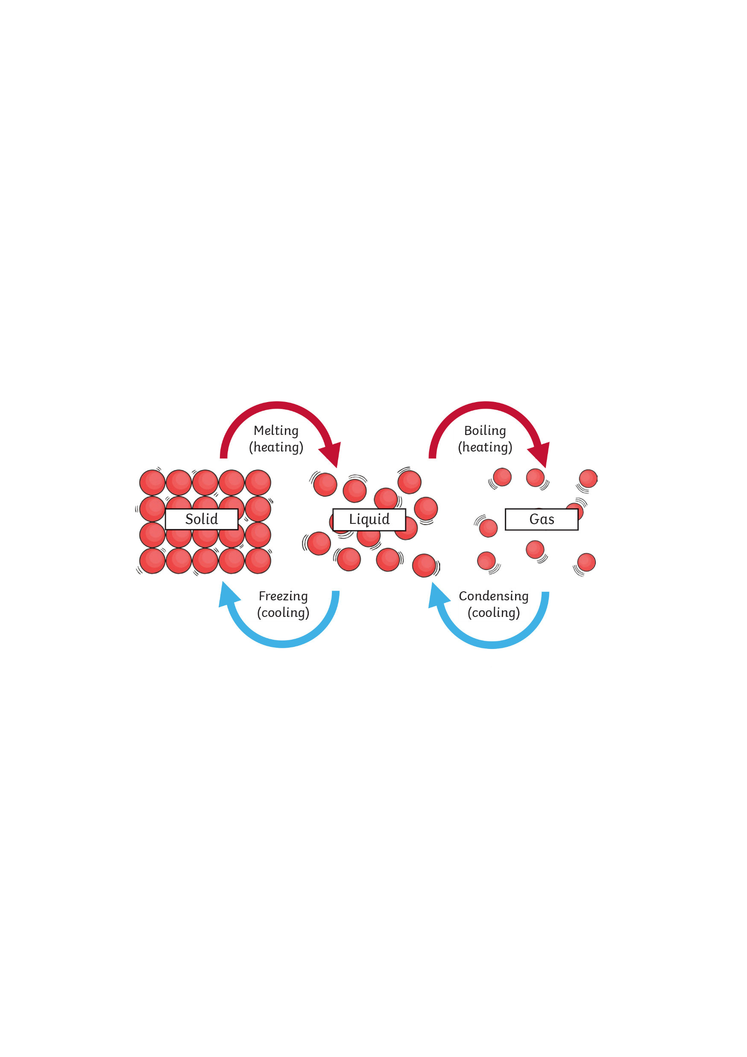
• Melting
Melting means heating a solid until the molecules can move about again, which will turn it into a liquid. Just like boiling points, each material has its own melting point, although these may vary drastically. For instance, chocolate will melt at a relatively low temperature. You could try to refrigerate a chocolate button then hold it in your hand and see what happens. Other materials, such as gold, require very high temperatures of over 1000°C!
A diagram to show the cycle of the states of matter

Slide 19
Materials can appear naturally at different states depending on their environment. Otherwise, we have to deliberately alter the temperature or pressure to force materials into changing state. There are a number of different ways we can utilise changing the state of a material, such as freezing food to keep it fresh, boiling water to purify it for drinking or melting gold to form it into jewellery.

Slide 20
Complete this skeleton. Include the three states of matter and how they change state.
Reversible effects
Back to original

Slide 21
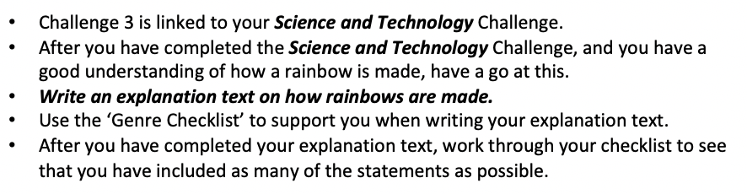
Challenge 3:

Slide 22
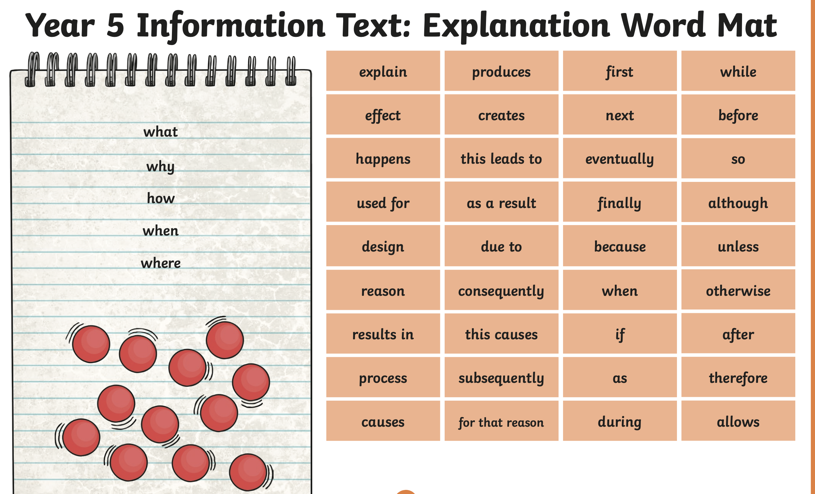

Slide 23



