Slide 1
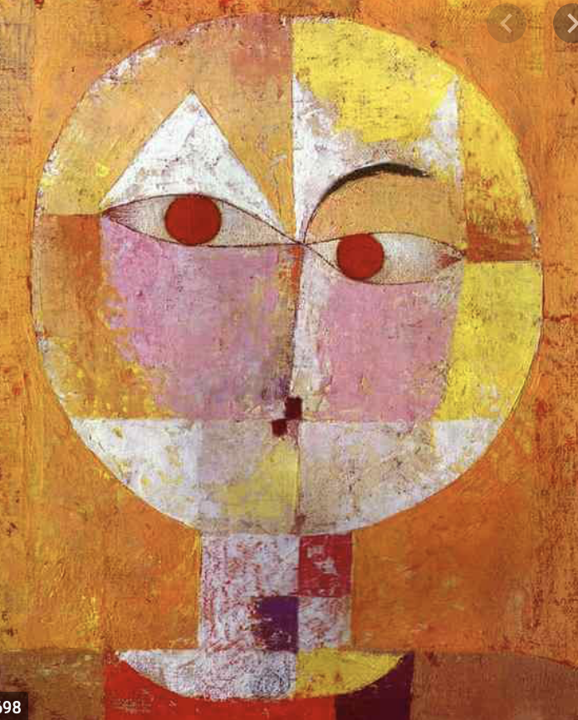
Paul Klee
Examples of Senecio by our Year 5 Pupils

Slide 2
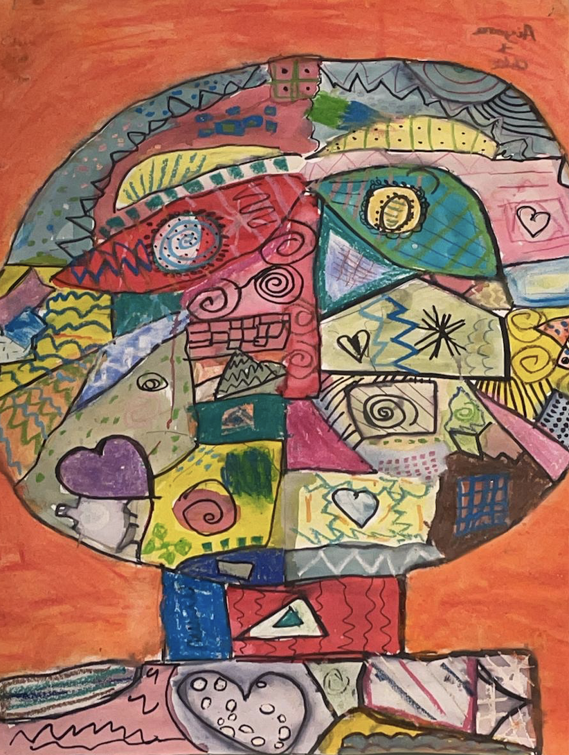

Slide 3
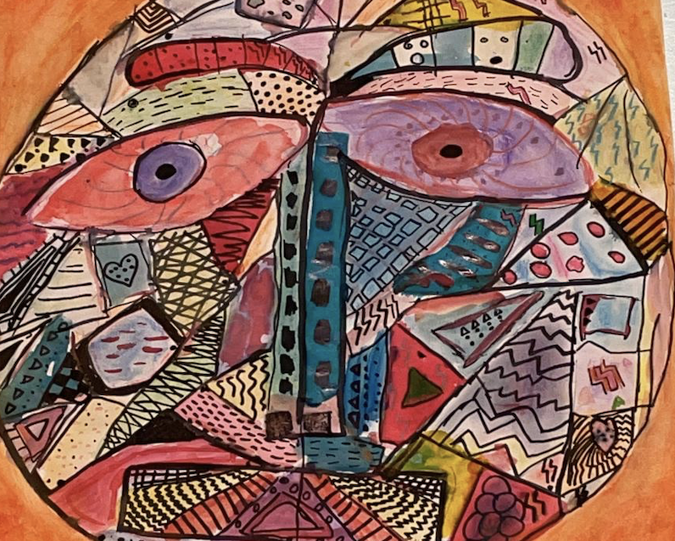

Slide 4


