Slide 1
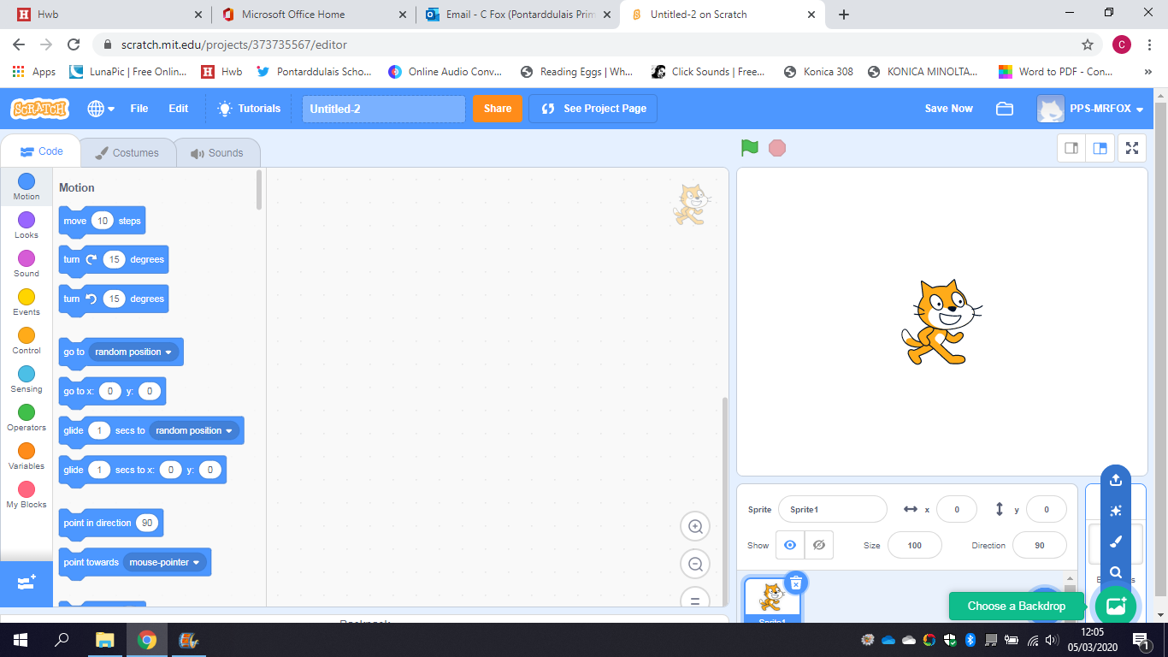
Coding with Scratch
Squash

Slide 2
Section 1
Making the basic court.

Slide 3
Creating a Background
Search for Scratch online or using web address www.scratch.mit.edu Login to Scratch using your username and password and start a new project. Select the background icon on bottom right and either search for one by clicking the magnifying glass, or draw one using paintbrush.

Slide 4
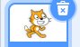
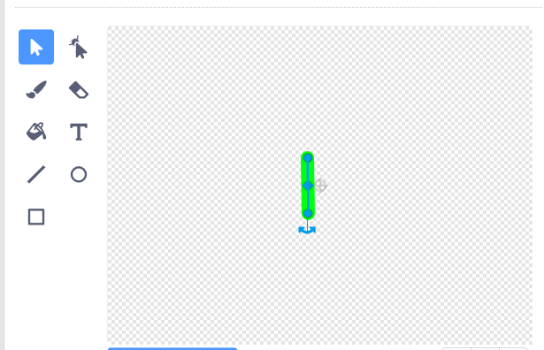
Creating a Sprite
For this sprite, we do not need the Cat sprite. Click on the trash symbol and draw a new sprite. For this sprite, draw a short, thick, brightly coloured line. Make sure the middle of the line sits on the small cross at the middle of the drawing pane.

Slide 5
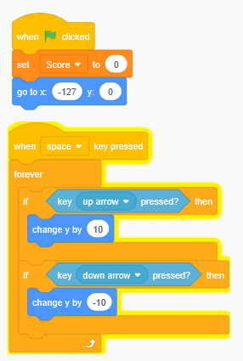
Code for the bat
Create this code for the line you created, which is your bat. This is so it always goes to a certain location and can move up and down. Change the numbers for different speeds.

Slide 6
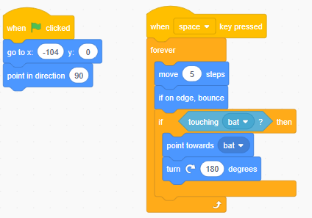
Ball
Now you can create the ball, either by finding one in the library or drawing one. Remember to centre it. Give your ball the following code.

Slide 7
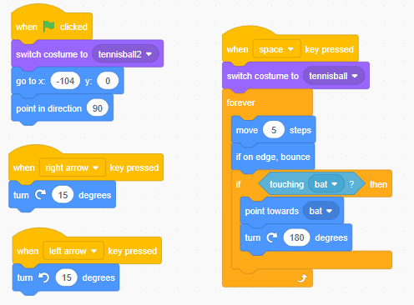
Aiming the Ball
Go to the ball’s costume, right click on costume 1 and duplicate it. On the duplicated costume draw a small arrow. Now rewrite your code like this:

Slide 8
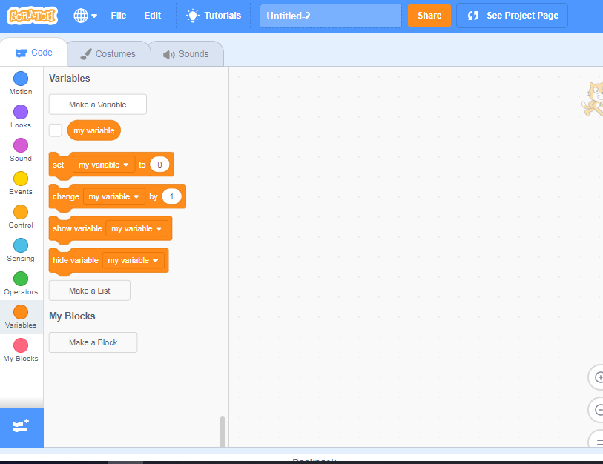
Creating a Variable
On your ball’s code tab, click on the orange variables dot and select Make a Variable. Create 2 and name them as ‘Score’ and ‘Speed’. Hide speed but show score.

Slide 9
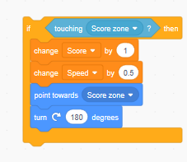
Score zone
Create another sprite of a line in a different colour and place it on the far end of the screen. When your ball hits the score zone you can get points. But it will change your speed. Put this code into ball’s coding.
Challenge: Add a code somewhere so that when green flag is pressed, score resets to 0

Slide 10
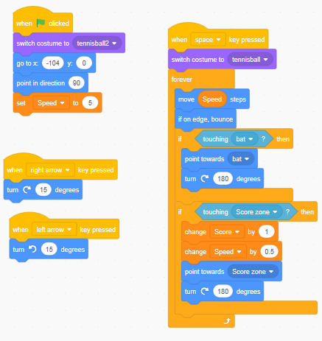
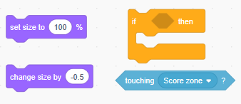
Affecting the ball
Go back and alter the ball’s coding to this. Try it out, alter some numbers to see which works better
Challenge: Using the code blocks below, can you also make the ball shrink by half each time with each score. Place them carefully so the ball is always 100% when game starts.

Slide 11
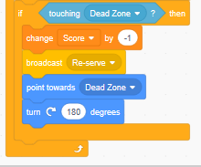
Dead Zone
Create another sprite named dead zone and make it a big rectangle behind your bat. Put coding in so it always goes there. Now, go to your ball sprite and add in this code.

Slide 12
Section 2
Levels and Lives

Slide 13
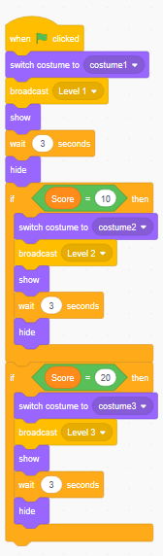
Levels
For a further challenge to your game, create levels. Create a new variable called level. Then, make a new sprite called levels also and draw it with text making a new costume for each level. Place this script near the bottom of the game screen. Give it this code.

Slide 14
Levelling up
By creating levels, your challenge is to make things alter for each level. For example, moving where the score zone is. Making the score zone or bat smaller is another good challenge. Have the score zone become a moving target. Reverse the controls, so that up means down and down means up. The background and look of the ball can change. Flip the screen so the score zone, bat and dead zone are on opposite sides. You can do whatever you want but make sure when green flag is pressed and the game resets to level 1 everything goes back to normal. Experiment.

Slide 15
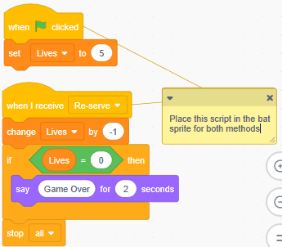
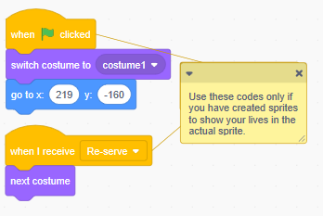
Lives
Create another variable called lives. You can show this on screen in 2 ways. Have the actual counter that appears when you create a variable to create a sprite for your lives, using hearts and then draw different costumes with different numbers of hearts, including a blank costume. Write this code.
Challenge: Write a code so if you get a certain score you get extra lives.

Slide 16
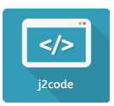
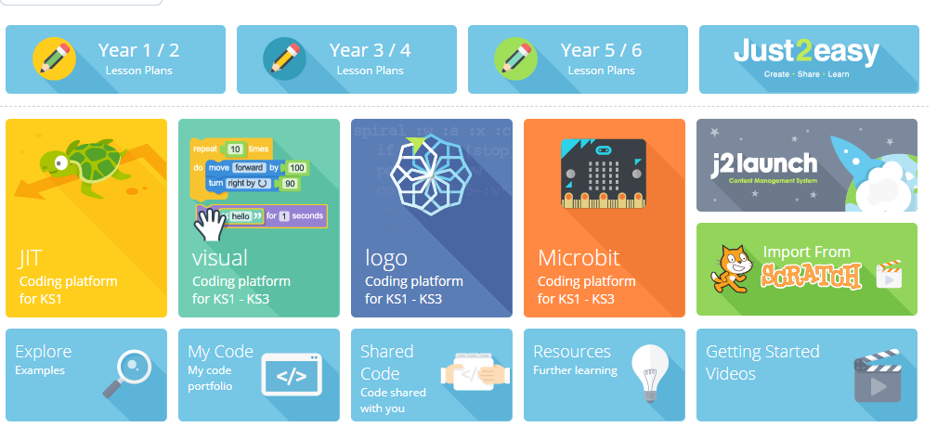
Sharing
Throughout, remember to save and name your file. When completed, click on Share. Now, go to HWB and into J2E. Go to J2Code, go down to the Scratch icon at the bottom and type in your Scratch username. All files will save to your J2E files.

Slide 17
Challenge
Can you create obstacles that appear at certain levels? Be it walls that stay still, move or spin. Think of what code is needed for its behaviour but make sure you put in the correct code to bounce.
In the pink sound coding, you can add in sound effects. Can you create different sound effects for when the ball hits the bat, the edges, the Score Zone and the Dead Zone?
Give your game a time limit. Create a variable for time and see who can get the most score and highest level.
If your score goes below a certain level by hitting the Dead Zone, can you make the level go back?

