Slide 1
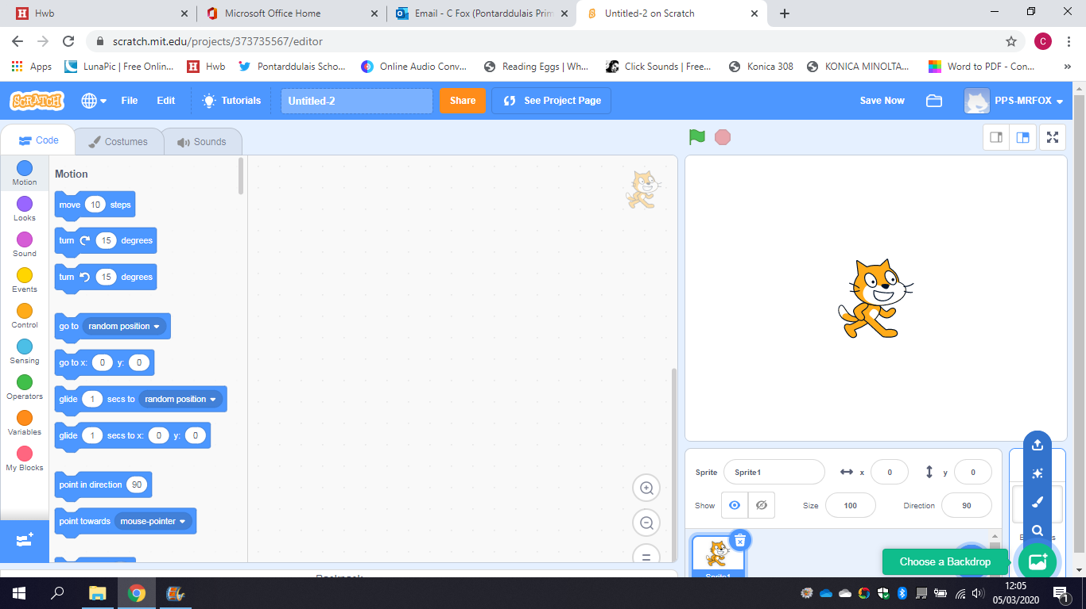
Coding with Scratch
Translator

Slide 2
Section 1
Making a Welsh Translator.

Slide 3
Creating a Background
Search for Scratch online or using web address www.scratch.mit.edu Login to Scratch using your username and password and start a new project. Select the background icon on bottom right and either search for one by clicking the magnifying glass, or draw one using paintbrush.

Slide 4
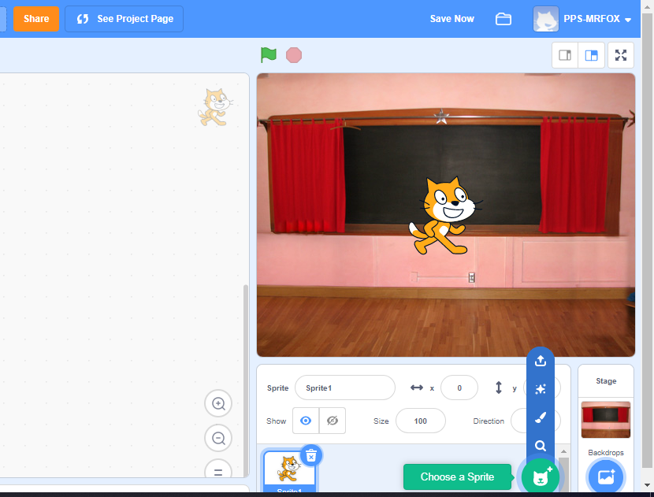
Creating a Sprite
You can either use the default Scratch Cat as your sprite, or click on the sprite icon to choose or draw your own. Once chosen, you can move your sprite to wherever you want on the screen.

Slide 5
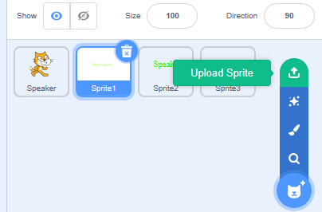
Uploading images
Download an image of the Welsh flag from Google and save to your computer. Now, go to new sprite, and select the upload sprite section and choose your flag.

Slide 6
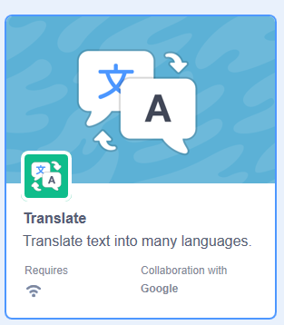
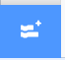
Translator
Before coding, you need the blocks for translating. Go to your main sprite and select the Code tab. At bottom you will see this symbol C Click on it and a selection of other codes appears. Select translate and you will have new coding blocks.

Slide 7
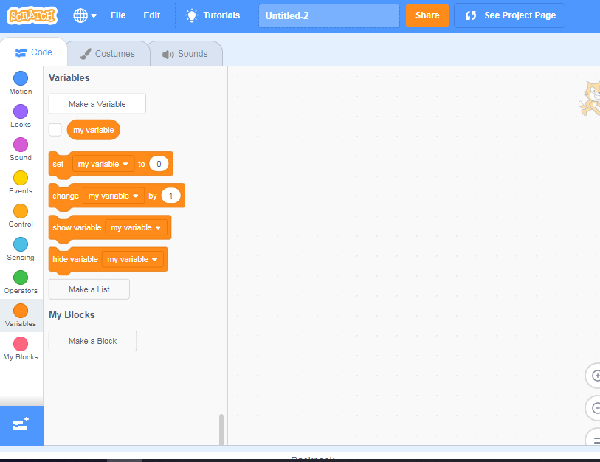
Creating a Variable
On your sprite’s code tab, click on the orange variables dot and select Make a Variable. Name it as ‘language’. Uncheck it to hide,

Slide 8
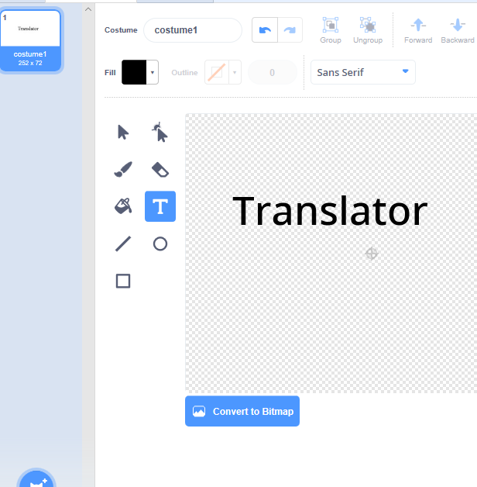
Creating a Title
Hover your mouse on the new sprite icon and click on the paintbrush. In the create section, click on the T symbol and type in your title. Colour and resize as you want and place it where you want in the gaming screen. Right click on the costume1 box and select duplicate. On the new costume, change the colour.

Slide 9
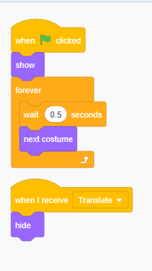
Creating a Title
For your title, type in these codes. In the ‘When I receive’ block, it will say new message. Click on the down arrow and create the new message Translate.

Slide 10
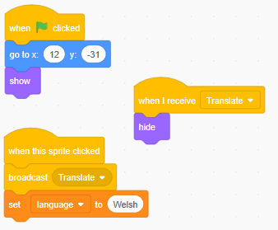
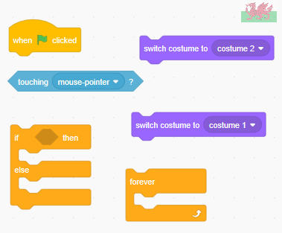
Flag button
Resize and place your flag where you want. Now, type in the following codes. Remember, your x and y co-ordinates will depend on where you place your flag.
Challenge: Create a second costume for the flag with a coloured line around it. Use the blocks below to create a code that shows you are selecting that flag.

Slide 11
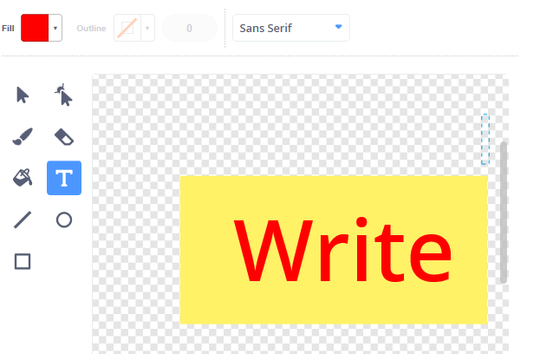
Prompt button
Create a new sprite by using the square button and text button and place in your game screen in a bottom corner.
Challenge: Mimic the previous challenge to show this button is being selected.

Slide 12

Prompt button coding
As well as the challenge coding, put this coding in.

Slide 13
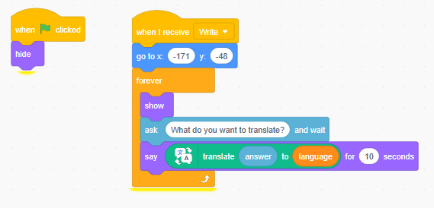
Coding your Translator
With your new coding blocks you can now code your translator. Try out your coding so far by typing in what you want translated when prompted. This will keep going until you reset the game by pressing the green flag.

Slide 14
Section 2
Making your translator speak to you.

Slide 15
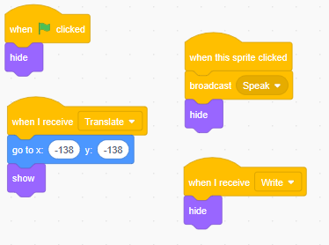
Speak prompt button.
Create another prompt button called speak in the same way as you did with the write prompt button. Use the following code for it. For the ‘When I receive Write Hide’ command, use a similar code in your Write prompt button for the Speak command.

Slide 16
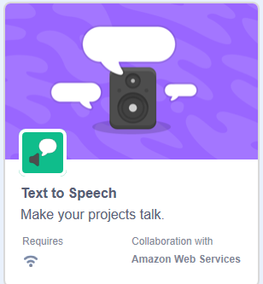
Speaking codes.
You need to add another set of coding blocks to make your sprite speak. Go to the add extension section and choose text to speech.

Slide 17
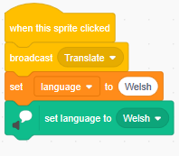
Speaking codes.
One thing that needs to be remembered is that Scratch is an American company, so some Welsh words will not be recognised. You must set the text to speech language setting to the correct language as such.

Slide 18
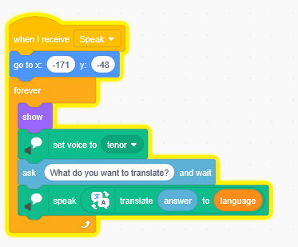
Making your sprite speak
Go back to your main sprite and put in the following code. Give it a try. Please remember it is an American accent so it may not sound exact.
Challenge: Play with the voice setting to find a voice you like.

Slide 19
Section 3
Making your translator a universal translator.

Slide 20
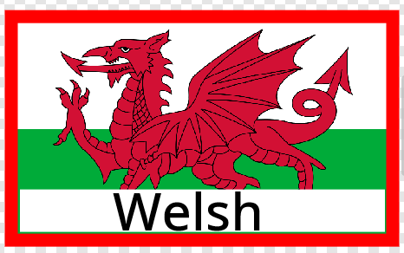
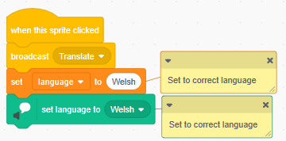
Adding other countries
Go back to creating the welsh flag. Repeat the method for other countries, as many as you wish. As not everyone will recognise the flags, add the language name to your second costume of the flag. So when your mouse hovers over it the flag highlights and shows name. Remember to have the same coding for each flag but with one alteration. Make sure they are arranged neatly.

Slide 21
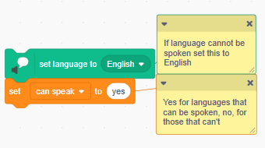
Not all speak
Not all languages allow for text to speech. If it doesn’t, put this code in the flags with a new variable called ‘can speak’. Add this block underneath the code you did above.

Slide 22
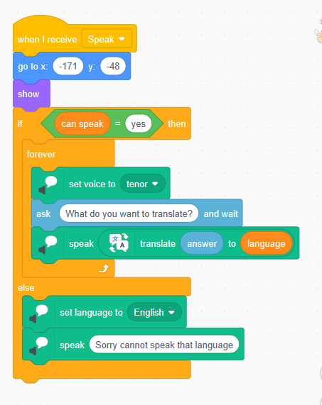
Not all speak
Go back to your translator sprite. Change the speaking code so it looks like this.

Slide 23
List of Languages that can be translated
Amharic
Arabic
Azerbaijami
Basque
Bulgarian
Catalan
Chinses (Simplified)
Chinese (Traditional)
Croatian
Czech
Danish
Dutch
English
Estonian
Finnish
French
Galician
German
Greek
Hebrew
Hungarian
Icelandic
Indonesian

Slide 24
List of Languages that can be translated
Irish
Italian
Japanese
Korean
Latvian
Lithuanian
Maori
Norwegian
Persian
Polish
Portuguese
Romanian
Russian
Scots Gaelic
Serbian
Slovak
Slovenian
Spanish
Swedish
Thai
Turkish
Ukrainian
Vietnamese
Welsh
Zulu

Slide 25
List of Languages that can be spoken
Arabic
Chinese (Mandarin)
Danish
Dutch
English
French
German
Hindi
Icelandic
Italian
Japanese
Korean
Norwegian
Polish
Portuguese (Brazilian)
Portuguese
Romanian
Russian
Spanish
Spanish (Latin America)
Swedish
Turkish
Welsh

Slide 26
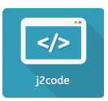
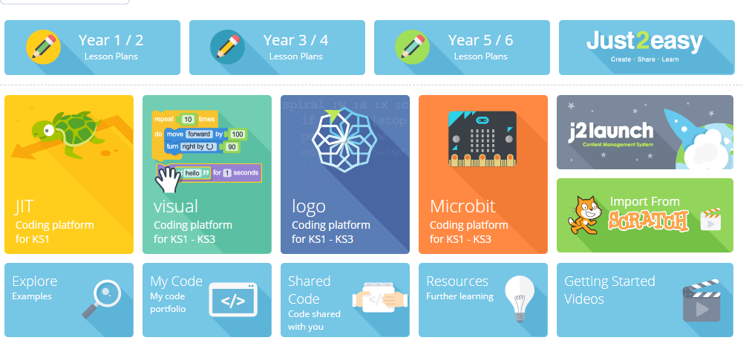
Sharing
Throughout, remember to save and name your file. When completed, click on Share. Now, go to HWB and into J2E. Go to J2Code, go down to the Scratch icon at the bottom and type in your Scratch username. All files will save to your J2E files.

Slide 27
Challenge
Can you give your translator sprite different costumes or props linking to the language they are speaking, e.g. leek for welsh, wearing a beret for French etc. Create coding that allows for this change.
Can you create backgrounds and coding so the background changes to match the language?
Can you create coding that sends you back to the main page without having to press the green flag?

