Slide 1
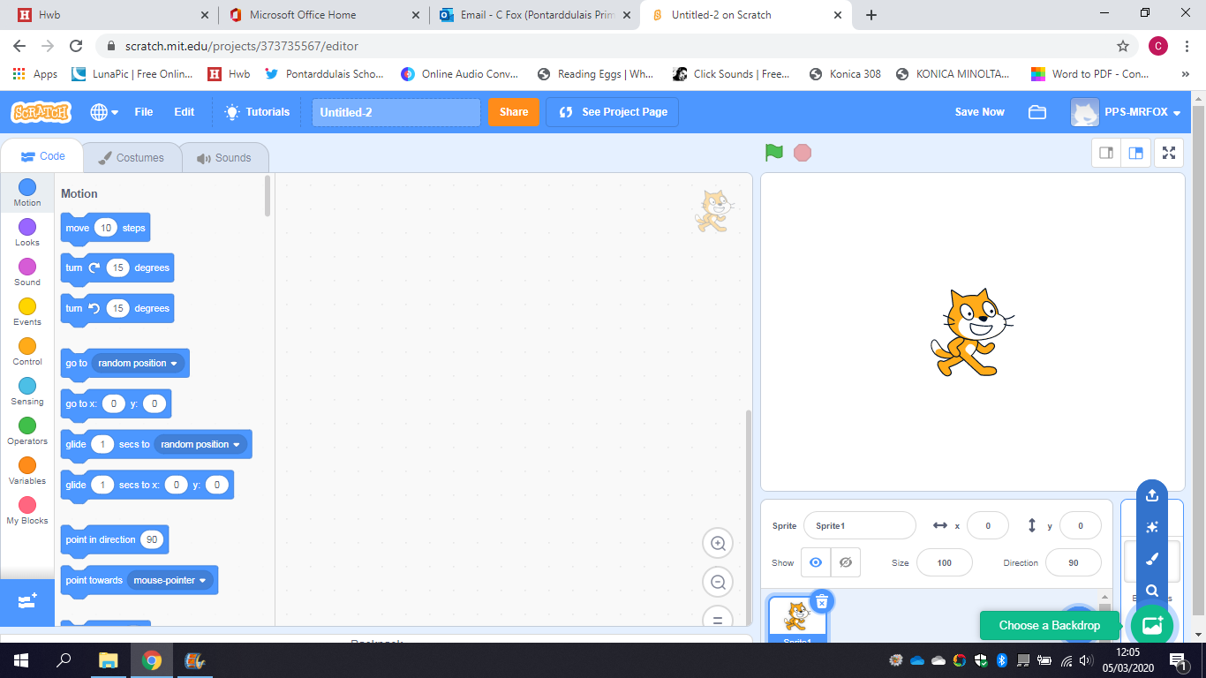
Coding with Scratch
Quiz

Slide 2
Section 1
Creating basic quiz with set out questions.

Slide 3
Creating a Background
Login to Scratch using your username and password and start a new project. Select the background icon on bottom right and either search for one by clicking the magnifying glass, or draw one using paintbrush.

Slide 4
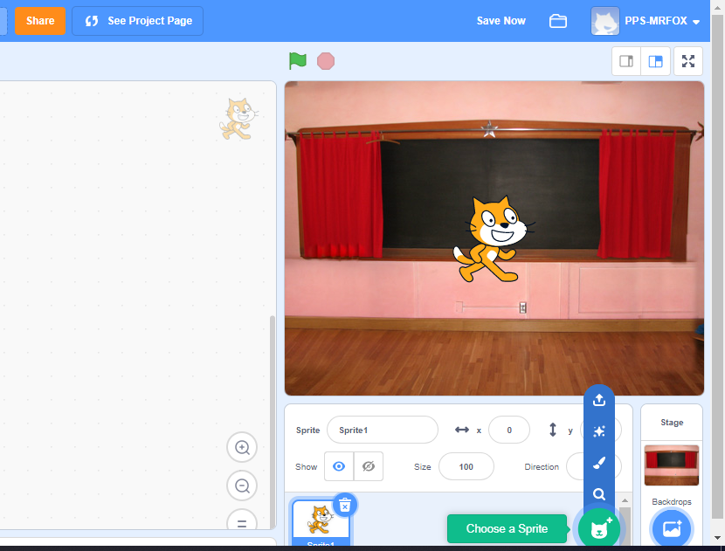
Creating a Sprite
You can either use the default Scratch Cat as your sprite, or click on the sprite icon to choose or draw your own. Once chosen, you can move your sprite to wherever you want on the screen.

Slide 5
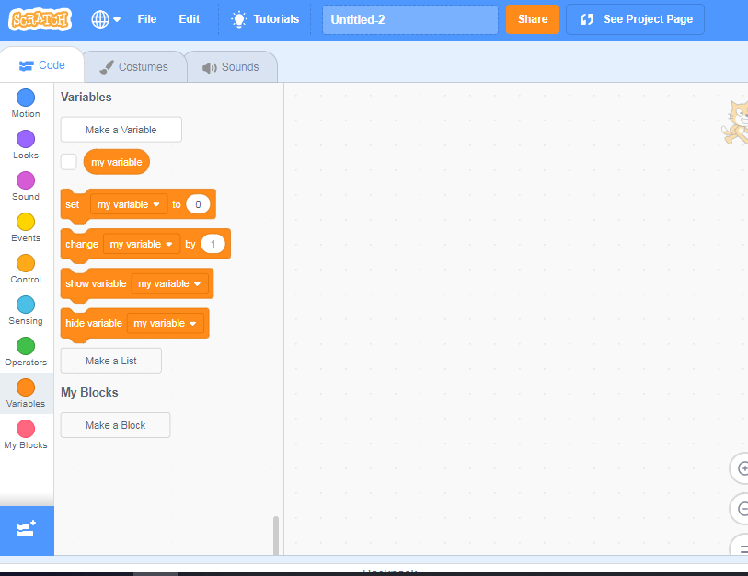
Creating a Variable
On your sprite’s code tab, click on the orange variables dot and select Make a Variable. Name it as ‘Score’. The score will appear on your screen.

Slide 6
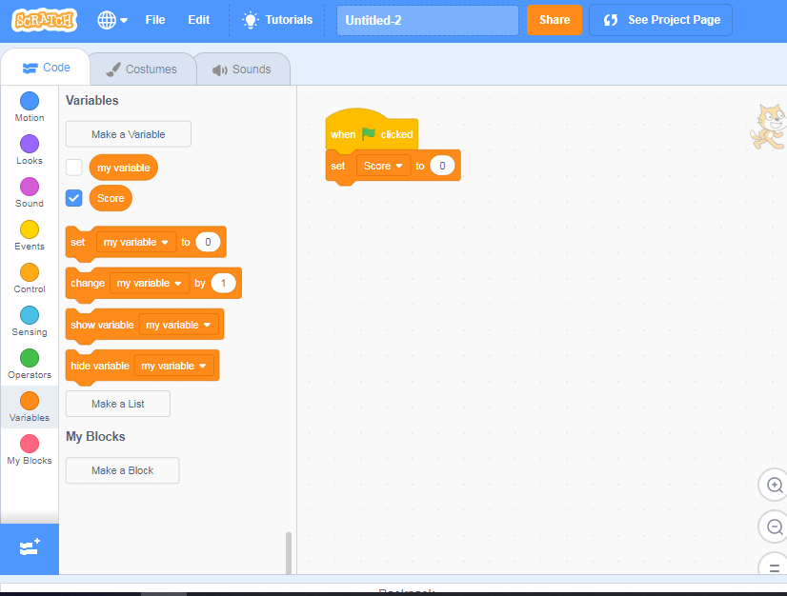
Coding your Score
Create this code by dragging the blocks in from the menu. ‘When Flag Clicked’ comes in from Yellow Events dot, and ‘Set my variable’ To 0 from orange Variables dot. Click on the down arrow and choose your score.

Slide 7
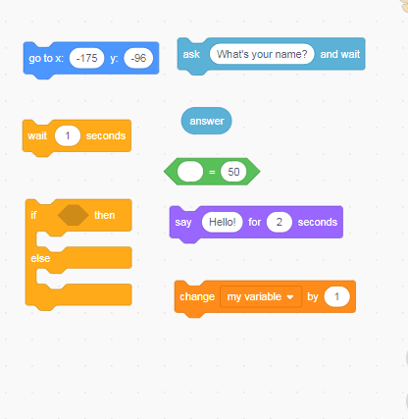
Coding for Questions
You are going to need the following coding blocks.
Challenge: try and find them from the correct coloured dots.

Slide 8
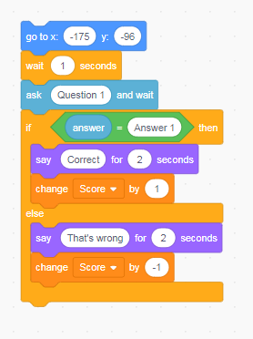
Coding for Questions cont
Place the blocks together like this. Make sure they clip together properly.
Challenge: the top block must have the co-ordinates your sprite is placed. Your question and answer must be basic enough so there are no mistakes.

Slide 9
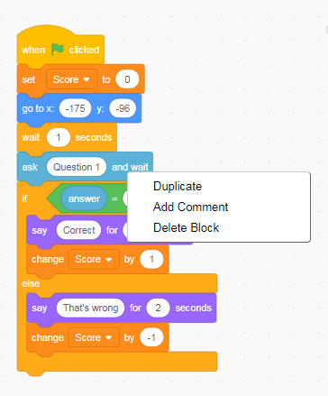
Coding for Questions cont
Drag the code to join with the Score coding. Now, right click on the first question block and press duplicate. Everything below will be copied. Clip it underneath to do another question.
Challenge: make as many questions as you can, making sure the answers match correctly.

Slide 10
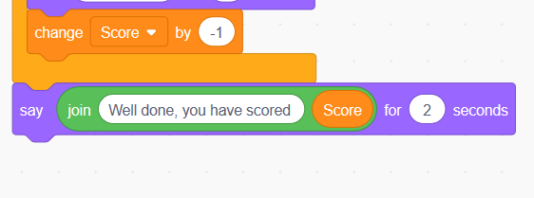
Coding for Questions complete
Your quiz must have an end. At the bottom of the code, add this section in to show you have finished and to give your final score.

Slide 11
Section 2
Advanced quiz with random questions

Slide 12
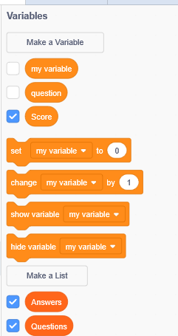
Coding for Random Questions
At the moment your quiz is straightforward and people will learn your questions. You need to create random questions. To do this, create another variable called ‘question’. Underneath, you will see a button saying ‘Make a List’. Create 2 called questions and answers

Slide 13
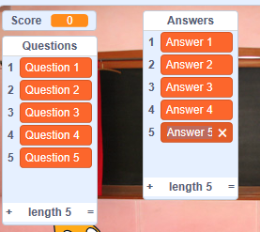
Coding for Random Questions
Cont
On your game screen, two boxes will appear for these two lists. Write down your questions and answers making sure they are correctly matching. Click the plus symbol to begin, click on the cross if you make a mistake. When finished, just uncheck the Answers and Questions in your list menu and they disappear.

Slide 14
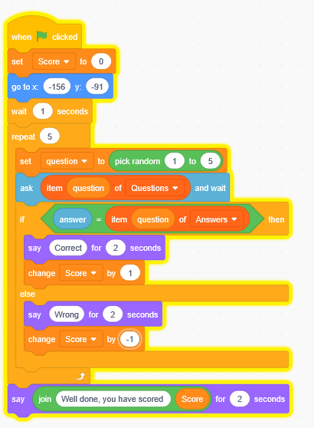
Coding for Random Questions
Cont
Now you have your list done, change your coding so it looks like this. The repeat section and Pick Random … to … will depend on how many questions and answers you have created.

Slide 15
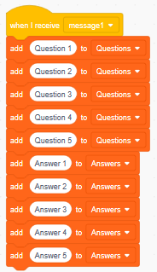
Coding for Random Questions
Cont
You may notice that some questions will be repeated. To stop this create this code writing your questions and answers in each block and remove the questions and answers from your list.

Slide 16
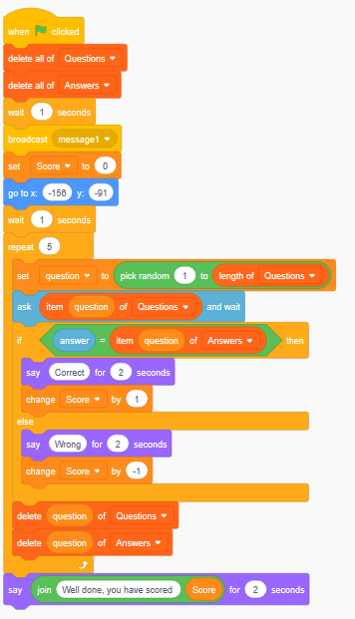
Coding for Random Questions
Cont
Rewrite your code so it looks like this:

Slide 17
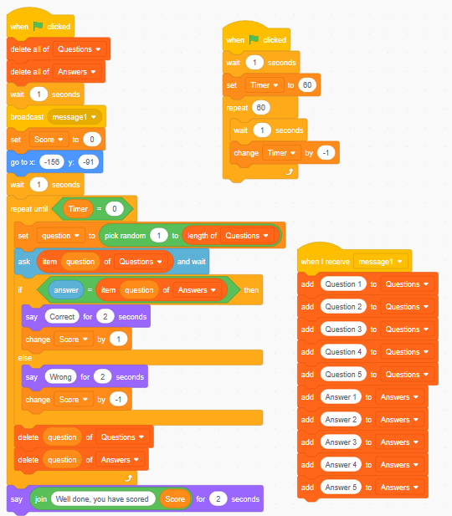
Coding for Random Questions
Completed
Your quiz is ready. Challenge your family and see who is the greatest quizmaster. Change your questions and answers on a regular basis. You can also change how to limit your game. By using the repeat function you can choose to ask only some of your question or all of them. Or, swap your repeat function for the following for a quickfire quiz and creating a new variable called timer.

Slide 18
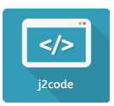
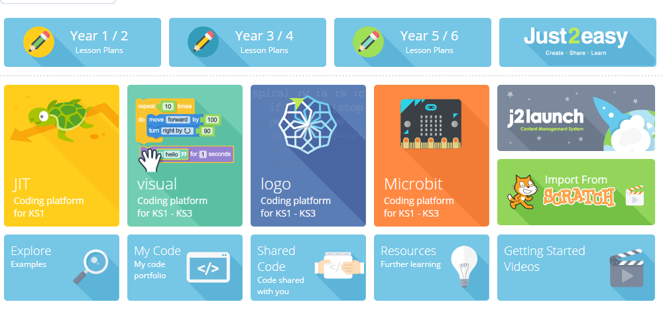
Sharing
Throughout, remember to save and name your file. When completed, click on Share. Now, go to HWB and into J2E. Go to J2Code, go down to the Scratch icon at the bottom and type in your Scratch username. All files will save to your J2E files.

Slide 19
Challenge
Can you add animation to the sprite to show correct or right answers?
Can you do something to the background to show end of game?
Can you add some text at beginning to introduce the game and rules?

